Slide 1
Measuring Innovation Impacts
Ghislaine Tremblay
Networks of Centres of Excellence
December 7, 2011

Slide 2
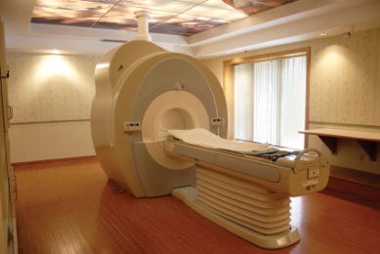
Capturing impacts
Impacts
Research
Time lag
results
Time lag
10 – 20+ years
Research
environment
Notes:
We are more than ever required to demonstrate impact and to be accountable. While success stories are an effective way to communicate examples of success, this has been increasingly inadequate when funders want substantive, quantified data to measure impact (needed to justify further funding). Funders want to know what has been their return on investments, for example how many jobs and companies have been created.
This information is particularly difficult to collect. Also impact can change depending at what point it is measured. Adding to this complex issue is that research may take many years to produce results. This is the reason that a lot of the current information being collected is on research outputs, such as the number of HQP trained, publications.

Slide 3
EOA
(Evaluation & Outcome Assessment)
Performance, Evaluation, Risk and Audit Framework
Outcome Measurement Studies (OMS)
Socio- Economic Impact Assessment
(SEIA)
Special Studies
&
Evaluations
Overall Performance Evaluation & Audit
Annual Project Progress Reports
Notes:
The CFI has developed new tools and approaches to measure innovation impacts in a meaningful way. The PERAF guides on evaluation activities.
I will speak to some of these in more detail in this presentation:
Project progress and institutional reports provide an annual overview of the progress of projects.
To date conducted 28 OMS visits, including in the theme of food science at Guelph-associated with the food network
The Plateform OMS will be looking at Canadian knowledge Research Network.
Through the Socio-economic Impact assessment we are looking at imaging technologies associated with networks
SEIA
POMS

Slide 4
Outcome Measurement Study
Why?
Respond to increasing demands and needs from the CFI Board and management, as well as other stakeholders
Need for a more inclusive approach to measure the CFI’s progress against its wider objectives
Get a wider understanding of the impact of CFI investments at the institutional and national levels
Notes:
Notes:
Respond to increasing demands and needs from the CFI Board and management, as well as other stakeholders
Increased government expenditures on research and development as well as growing interest of policymakers to maximize the social and economic returns of these investments have been accompanied by a growing insistence on demonstrating the value of publicly funded research for accountability reasons.
The CFI Board, management and stakeholders have recognized this trend and called for greater learning and evidence relative to the “impacts” of the CFI investments.
Need for a more inclusive approach to measure the CFI’s progress against its wider objectives
Efforts toward promoting and measuring impacts of publicly funded research required a shift to more comprehensive and meaningful measurement of results. Not only should measuring the outcomes of research take some of the focus away from outputs but it should include capturing the broad social and economic impacts of research.
The research landscape is complex and multi-actored (multi/inter-disciplinarity, globalization). Moreover, annual project progress reports (PPR) are of limited value to measure long-term outcomes and socio-economic impacts (and CFI strategic objectives that relate to them). A tailored approach that is better suited to deal with the complexities of the S&T and innovation processes is needed.
Get a wider understanding of the impact of CFI investments at the institutional and national levels
Strive for a more holistic performance assessment that not only better demonstrates the value of research investments but also returns learning dividends to CFI.
Infrastructure investments are generally not done in isolation; CFI is one of many actors in the public funding of research and CFI investments are to be in line with strategic objectives of the institution. Accordingly, the CFI must:
Better understand it’s contribution to outcomes (including capacity building at the institutional and national levels) as opposed to what can be attributed to CFI;
Assess the significance of the relationships between strategic goals, funded projects, and outcomes.

Slide 5
OMS Features
Unit of analysis
One theme within an institution
Method
Case study
Validation
International expert panel
Combines before & after
Qualitative and quantitative
Reveals unexpected outcomes
Identification of success stories
Strengths
Burden on institutions
Challenge of extrapolating findings
Attribution and R&D time lag
Limitations
Notes:
The CFI has pioneered a novel methodology designed to capture the full range of impacts that result from its investments and those of its partners. driven by what is meaningful in terms of outcomes, not what is measurable” (Boaz et al. 2009, 267)
Unit of analysis: A theme approach was chosen rather than a project-based approach because it is more suitable to obtain a more holistic view and gain a greater understanding of the impacts of CFI funded infrastructure on an institution as a whole or even on the community it is a part of. (The theme is defined as a grouping of projects unified by a field of application or common scientific objectives.) The selection of a theme for an OMS visit is made jointly by the CFI and the participating institutions.
Method: A modified case study approach was chosen because the CFI funds research infrastructure in all disciplines, the projects are of different sizes and amounts etc. The OMS methodology allows for collecting evidence and reporting outcomes that traditional indicators such as publication and patent numbers can not readily depict including the broader socio-economic impacts that are less tangible and more difficult to capture.
Validation: Experts meet institutional representatives at 1.5 day visit where the can question the institution on the reported data. Expert Panel assess the degree to which the CFI infrastructure is a critical contributing factor. The unintended effect has been good PR for Canadian science.
Strengths: The OMS combines positive attributes of other methods (i.e. before/after, longitudinal data), Qualitative analysis is complemented or triangulated with the use of quantitative measures such as performance indicators, and bibliometric data.
Provides ability to detect unexpected mechanisms or outcomes through its open format Q&A; and enables us to identify success stories. We invite partners. We prepare a summary report and dashcard for our board of directors.
Challenges
Burden: The OMS puts a heavy burden on institutions. Institutions do not collect all required data (where are the students) and the OMS does not fit the natural academic structure of departments.
Generalization of data: We are collecting great information on individual institutions but find it difficult to talk about the overall CFI investment in institutions across Canada.
Attribution: CFI typically just funds 40% of infrastructure and is only one of many contributors to the research outcomes. This is the reason we invite the federal granting councils and the provinces to our visits.
R&D time lag : Research shows that the time lag on achieving benefits from research will often extend beyond the 10-year period of our OMS studies. Very large infrastructure takes more than 5 years just to become fully operational.

Slide 6
OMS Categories
Strategic research planning (SRP)
Research Capacity
Highly Qualified Personnel (HQP)
Research productivity
Innovation / Extrinsic Benefits
Notes:
Outcome categories reflect the CFI’s objectives
We have learned much about our investments through information provided on strategic research planning and innovation. It has been challenging to capture information on the end users but we are going as downstream as possible.
Strategic Research Planning (and the role of the CFI)
SRP process - External influences on SRP - External effects of SRP - Sharing of infrastructure - Complementary investments by institution
Research Capacity
Investment value of infrastructure - Capabilities (technical and operational) - Sponsored research funding - Critical mass - Recruitment and retention - Visiting researchers - Multi-disciplinarity
Highly-qualified research personnel
Number of research trainees - Nature of training, quality and relevance - Technology and knowledge transfer through HQP
Research productivity (intrinsic measures)
Competitiveness - Research productivity - External research linkages - External use of infrastructure
Innovation/extrinsic benefits
Leverage - Type of knowledge/technology transfer - Amount of transfer - Key innovations, number and importance - Evolving clusters
EP aims to assess the degree to which the CFI infrastructure is a critical contributing factor. E.g., the outcomes would not have occurred, or the impact on the extent or rate of evolution of the research within the thematic area.
Indicators were vetted thru pilots and an international review committee.
Indicators allow for both quantitative and qualitative assessments.
Within each outcome categories 3 to 7 indicators are measured or assessed. Overall, 22 indicators are used.
SRP- Complementary investment by institutions (human and financial)
Research Capacity – Capabilities (technical and operational)

Slide 7
Learnings
Theme
Institution
Community
Notes:
Theme EFFECT: One very important finding of the OMS visits is the collective power of integrating a collection of state-of-the-art equipment in facilities to maximize their use.
INSTITUTIONAL EFFECT: the impact of the institution purposely putting in place programs and structures that enhance the potential for positive outcomes – e.g. new undergrad and graduate programs, centers or institutes.
CLUSTER OR REGIONAL EFFECT: Institutions that coordinate at the regional level, their research with other academic institutions, federal and provincial organizations, and the private sector, can result in a local/regional ‘clustering’ effect. This may lead to new and enhanced products and services. An example is the pharmaceutical cluster in Montreal.
In addition:
CFI: better able to report to CFI board of directors, the government of Canada and other key stakeholders.
Findings are included in the 2010 OPEA, the CFI annual report, and EOAs report on results; and
Better able to communicate success stories (Innovation Canada).
Institutions: gained insight into how to improve their own strategic research planning, has lead to better research coordination, used the information to promote their themes to funders and other stakeholders.

Slide 8
Platform OMS
Examples
Why?
Sizeable investments by CFI in platforms
Main features of research platforms:
Long lifetimes
Unique capabilities
From big science facilities to distributed resources
National and international users
Customized governance structure
Canadian Light Source
Compute Canada
Canadian Research Knowledge Network (CRKN)
ONC (CECR)
Amundsen (an important component of the ArticNet NCE)
VIDO-INTERVAC, a partner of PREVENT (CECR),
Toronto Centre for Phenogenomics
Notes:
The CFI has made—and will continue to make—significant investments in the infrastructure, operations and maintenance of a number of national and regional research platforms through its different programs (Platform fund, International fund, LEF-NIF, MSI).
As technology developed, and new infrastructure become increasingly complex and more expensive to develop and sustain, research communities will increasingly rely on more centralised platforms. In some areas, international facilities are even being built or considered to provide the basis for integrated and large scale research efforts.
Features of research platforms make the assessment of their outcomes challenging.
The types of infrastructure that fall into this class are typically those that are large and very expensive, have long useful lifetimes (e.g. 10 + years), and offer unique capabilities within Canada.
Platforms are very diverse going from unique and highly specialized physical facility (CLS) to relatively “generic” organizations that can provide support services for research users in a broad range of disciplines and fields of application (CRKN, Compute Canada);
Platforms support national and international users and often including public and private sector users. As such, they offer multidisciplinary research opportunities, support the exploitation of research strengths that cut across the Nation, and provide an important location for scientific, academic and business collaboration. Their activities go beyond research, they have specialized technical, professional and business personnel who manage the operations, maintenance and development of the infrastructure (e.g., outreach);
Often have their own governance structure.
Current evaluation and outcome assessment tools (including those of CFI) are not ideally suited to assess the outcomes of “organizations” that are so diverse.

Slide 9
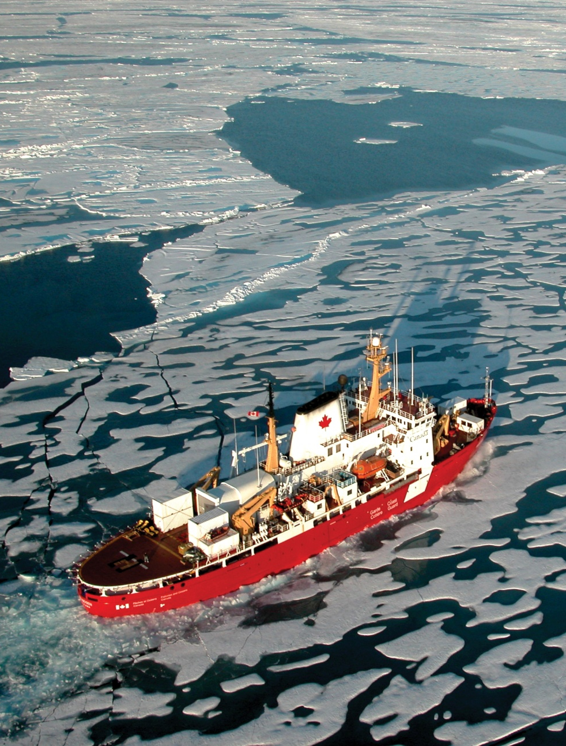
Platform OMS
Features
OMS as a blueprint
Holistic view at platform activities
Contextualized approach structured around 3 core outcome categories
Customization and partnership
Pilot visit in 2012
Notes:
Uses the “classic” OMS approach as a blueprint to develop a specialized methodology allowing the assessment of virtual (e.g., Compute Canada) and physical (e.g., TCP) research platforms as well as other major infrastructure investments such as MSI projects.
Holistic view at platform activities: The assessment will extend to all aspects/dimensions of the platform whether or not they have been funded by CFI, including physical and computational infrastructure, databases and personnel.
Assessment structured around three core outcomes categories (Capacity, Research, and Innovation)
Recognizing that research platforms can be very different, one from another, some customization is expected for each review. Advance discussions will take place between the CFI and the platform. These discussions will serve to identify indicators and metrics that recognize the specificity of the platform while ensuring that a common set of measures is maintained between visits. It is hoped that through such discussions CFI will enhance the level of involvement of platform staff and researchers in the process of assessment.
The Canadian Research Knowledge Network (CRKN) assisted with the development of the platform OMS (POMS) and will host a pilot visit in 2012. This will represent CFIs first attempt to assess if the POMS tailored approach allows capturing and measuring the outcomes stemming from the highly heterogeneous activities of CFI-funded research platforms.

Slide 10
Socio-economic Assessment
Why?
… to quantify the benefits that have accrued to society from public funding of physical research infrastructure (CFI) and research projects (CIHR).
Notes:
SEIA ‘why’ slide…
Over the past five years, the CFI has made great strides through the Outcome Measurement Study (OMS). Discussed previously
The OMS brings the CFI closer to understanding the impacts of CFI-investments
however it has not been feasible to fully pursue the broader social and economic benefits within the current framework.
The Canada Foundation for Innovation, in partnership with the Canadian Institutes of Health Research, has contracted with RTI International, a non-profit research institute, to conduct an economic analysis of public investment in medical imaging technology.
The goals of the study are to :
offer a dimension of accountability for public spending on medical imaging R&D, in keeping with Canada’s S&T Strategy.
discuss program and policy implications and provide recommendations to the CFI and CIHR to inform future initiatives
provide a lens into how the knowledge and technology associated with that R&D touches the lives of all Canadians through enhanced products and services, improved clinical outcomes.

Slide 11
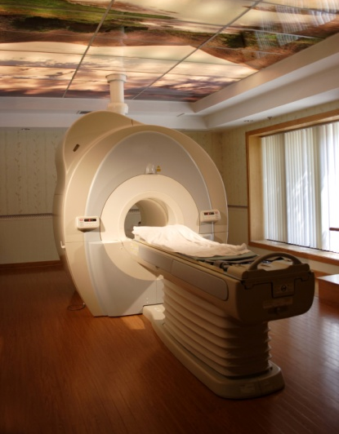
SEIA Features
Specific objectives:
quantify net public economic benefits;
offer a broad narrative; and
characterise economic roles
Notes:
SEIA ‘what’ slide…
Specifically, the objectives of the study are to:
quantify net public economic benefits accruing from CFI co-funded investments in Canada’s physical research infrastructure;
quantify net public economic benefits accruing from CIHR co-funded investments in Canada’s health research enterprise;
offer a broad narrative of the extent to which the CFI and CIHR generated or enabled the generation of value for all Canadians;
characterise the economic roles of the CFI and CIHR, their investments, partner organizations, and research outcomes
NOTE: Expect preliminary findings by the end of March with final documents to be delivered by late May.

Slide 12
SEIA Approach
Builds on the OMS
Iterative process to refine scope
Cost basis & “denominator” selection
Impacts – quantification of & narrative
Notes:
How did we/are we going about developing the SEIA
Initially, OMS health themes selected to allow partnership with CIHR
Two themes selected based on success of visit and potential for capturing downstream impacts:
Western – Musculoskeletal
McGill – Neuroscience: Brain and cognition
Site visits conducted to:
1. learn about the research, or that of the research group;
2. understand how the research was supported by CFI and CIHR, and how (and if) it would have been possible without the funding; and
3. document ways in which the research has had an impact on society either directly or through being embodied in products and services, or by being used for or informing clinical research.
Iterative process:
Very quickly, interviews [with project leaders and project users] revealed that there was an overarching theme evident, i.e., medical imaging – thus re-scoping. Interviewees also made it clear that one cannot comment on advances associated with medical imaging w/o-at a minimum-talking to UBC and UofT ….
Cluster theory: lower bound measures of return using Cost basis - Challenges associated with the development of the ‘denominator’:
in response, the CFI and the CIHR are assembling technology classes through key word searches
Three buckets of costs for CFI:
All CFI from beginning to end of FY11
All CFI medical imaging (based on keyword searches)
All CFI medical imaging based on keyword searches for in-scope institutions
Net Present Value, Benefit Cost Ratio, and Internal Rate of Return will be calculated for the second and third
to support the selection, CFI/CIHR are working with OST to conduct an analysis of patents and papers in the field of medical imaging – this will allow us to cross reference cited papers and patents, which should then provide evidence for the selection of components of our denominator
Technology selection: (based on interviews and review/potential to capture possible downstream benefit data)
Computational methods and systems
Enhancements to technologies and methods for MRI, MEG, Ultrasound
Image-guided surgical interventions
UBC and UofT TBD
End-users: interviews or (the possibility of a survey)
Medical imaging hardware, software, and services
Radiologists
Health systems
Clinical and academic research
Pharmaceutical and medical device firms

Slide 13
Target of analysis
SYSTEM
ORGANIZATION
PORTFOLIO
PROGRAM
PROJECTS
Notes:
The project focus allows depth, but it can be narrow and inefficient. We have found that the portfolio approach allows for the evaluation of a diversity of projects or programs and provides an understanding of the bigger picture. The effects of collaboration, and the globalization of research can also be better captured at this level.
The Federal gov’t prefers a system-wide approach, since impacts are the product of the whole R&D system and not exclusively produced by the original researchers themselves.
In the case of the CFI, the infrastructure cannot be used without the support of other funders. We must try to look at the whole system of R&D.

Slide 14
Thank you!

Slide 15
Ghislaine Tremblay
Director, Evaluation & Outcome Assessment
ghislaine.tremblay@innovation.ca

