Slide 1
Mobilizing Knowledge for Engaged Scholarship in the Digital Era
By Dr. Chad Gaffield
NCE
December 2011

Slide 2
Tom Jenkins` Foundation Principle
Competition
Innovation
Productivity
Tom Jenkins, Dec 5, 2011
2

Slide 3
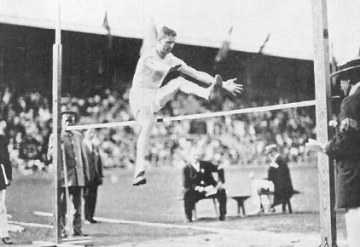

Slide 4


Slide 5
``…our future economic success will be defined by greater collaboration—not only outside of our own respective comfort zones, as businesses, researchers and government here in Canada, but also beyond our borders.
This is why the Government of Canada continues to support and encourage collaborations through the Networks of Centres of Excellence (NCE) programs.
We know that strengthening research linkages with peer institutions and with the private sector generates positive impacts for our economy and society, and it accelerates the exchange of research results.``
The Honourable Gary Goodyear, PC, MP
Minister of State (Science and Technology)
December 6, 2011

Slide 6
Collaboration
Innovation
Positive impacts for our economy and society
6

Slide 7
``…we know that innovation is a team sport…``
Suzanne Fortier Ph.D.
President, NSERC
December 6, 2011

Slide 8


Slide 9
``…promoting a culture of innovation…``
Suzanne Fortier Ph.D.
President, NSERC
December 6, 2011

Slide 10
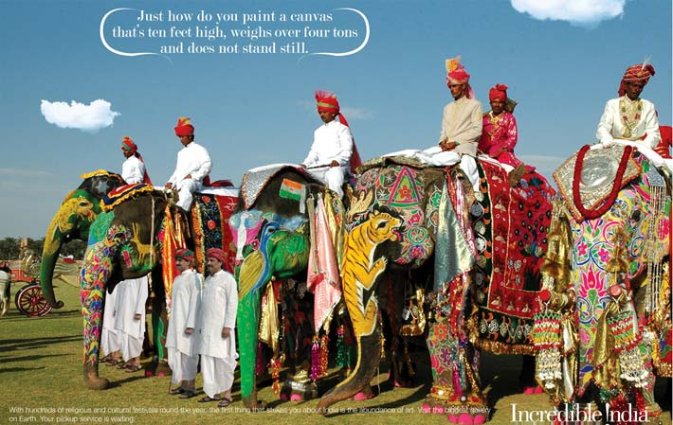
Notes:
This is from India’s major advertising campaign “Incredible India”

Slide 11
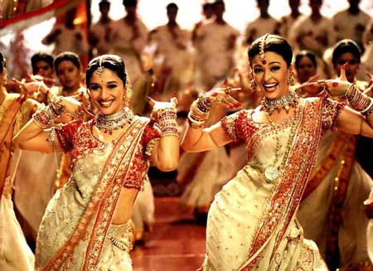

Slide 12
Talent
“People are the heart of the innovation process… Innovation relies on a skilled labour force, not only for high technology and research sectors, but throughout the economy and society…
They generate the ideas and knowledge that power innovation, and then apply this knowledge and the resulting technologies, products and services in the workplace and throughout society…”
  OECD Innovation Strategy, 2010
12

Slide 13
The social sciences and humanities focus on
People…
human thought and behaviour in the past and present…
with a view toward creating a better future.

Slide 14
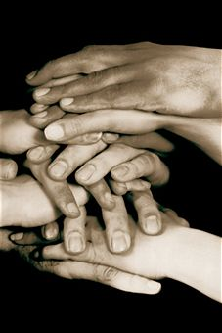
At SSHRC:
FOSTERING AN ENGAGED APPROACH
Fostering connections with and among key audiences on university and college campuses, in communities, and across public, private and non-governmental organizations.
To enhance informed decision-making on SSHRC programs, policies and directions
To allow research knowledge to flow both within the academic world, and between academic researchers and the wider community

Slide 15
SSHRC`s Knowledge Mobilization Strategy
Facilitate and enable the accessibility and impact of research by increasing and enhancing the flow of research knowledge among researchers, and between researchers and knowledge users
Improve research connections by facilitating reciprocal relationships between researchers and knowledge users for the (co-)creation and use of research knowledge
Enhance the quality of knowledge mobilization by developing networks, tools and best practices

Slide 16


Knowledge Transfer model
Impact
University / Université
Society / Société
12/7/2011
16
Notes:
16
As you know, scholarlship is not a-synchronous with KMb
KMb is a way of generating valuable scholarship
Validates research: test theory against practice; test observations, conclusions, insights with other experts
Draws in new data, information, ideas
Draws in material supports: people, money, facilities, connections

Slide 17

KMb: two-way
Socio-economic impact
University / Université
Society / Société
Academic impact (quality)
12/7/2011
17
Notes:
17
C’est un modèle bi-directionnel
La co-production du savoir est un modèle à deux sens.
Les connaissances acquises via les universités ont un impact qualitatif sur la société qui à son tour permet de gérer de nouvelles connaissances sur lesquelles les universités peuvent se pencher.

Slide 18
The KMb ‘Powerhouse
Impact
Research partners, non-academic researchers
Governments NGOs
Businesses
University scholars
University scholars
Quality
12/7/2011
18
Notes:
18
University includes college
Traditional university cycle: disseminate research results to other academics – to validate
Get their criticism in order to…. improve knowledge
So a cycle of Impact and quality – a virtuous circle
Same for realtionship between university and society, or external community
Researchers apply their knowledge, publish their knowledge to have impact – on society’s issues, on culture, on community life
The application can be via teaching, or public lectures, or newspaper articles, or contracts with the govt, or work with NGOs
Not all university researchers are involved, nor involved all the time – some are just working with other academics – but at any one time, a % of academics are involved in moving knowledge out
Coming back the other direction:
As with academics reviewing the work of other academics, non-academic experts (notably those closest to the academy) can offer valuable critiques of scholarly work
In any given area of human interest – there are experts everywhere
The challenge is that they all think and speak, and act in different ways
So Kmb is about articulating relationship between diverse agents – across sectors, fields, cultures, countries
Impact or application of knoweldge
Quality or validation of knowledge
KMb: validating knowledge on both or all sides
KMb: relevance of what we hold – but also of what is held by others
SSHRC’s work: to establish and maintain valuable connections
You want all the impact relations in place = all the quality relations

Slide 19
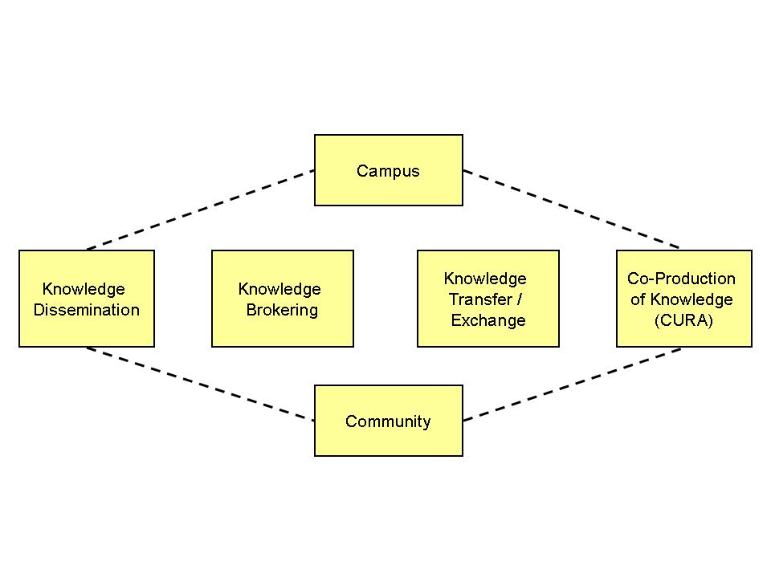
KMb: inclusive for SSHRC
12/7/2011
19
19
19
Notes:
19
KMb is an all-inclusive term for SSHRC – e.g., includes KE
There are many pathways for knowledge mobilization, to connecting the scholars with each other and to the campus to the community.
There is no "cookie cutter" approach, no one size that fits all.
SSHRC is promoting knowledge mobilization as an inclusive, umbrella concept.
It includes knowledge dissemination, knowledge transfer/exchange, knowledge brokering and co-creation of knowledge.
Traditional dissemination
Enhanced dissemination
Knowledge Translation
Knowledge Synthesis
Knowledge Transfer
Co-production of knowledge

Slide 20
SSHRC Research Data Policy (from early 1990s)
``All research data collected with the use of SSHRC funds must be preserved and made available for use by others within a reasonable period of time. SSHRC considers "a reasonable period" to be within two years of the completion of the research project for which the data was collected.
The purpose of this policy is:
To facilitate the advancement of knowledge in the social sciences and humanities by encouraging researchers to share research data
Greater availability of research data will contribute to improved training for graduate and undergraduate students``

Slide 21

The 20th Century
Linear Model of Innovation
Source: Industry Canada, 1996-97 Performance Report

Slide 22
20th century linear approach
Focus on economic growth through successful businesses
Then, use wealth to enhance quality of life (health, education, welfare)

Slide 23
20th Century Model of Innovation
21st Century Model of Innovation
Push
Push, Pull and co-create
One-way flow
Multidirectional flows
Tech transfer
People moving ideas and knowledge
Linear recipe
Non-linear engagement
(uncertainty, small big)
“Experts” to “Receptors”
Multi sector innovation participants
Tool makers
Tool makers and Tool users
STEM disciplines
STEM + SSH + AD
Autonomous roles, Competition
Competition and Collaboration, networks, partnerships, clusters
Physical contact
Physical + virtual communities

Slide 24
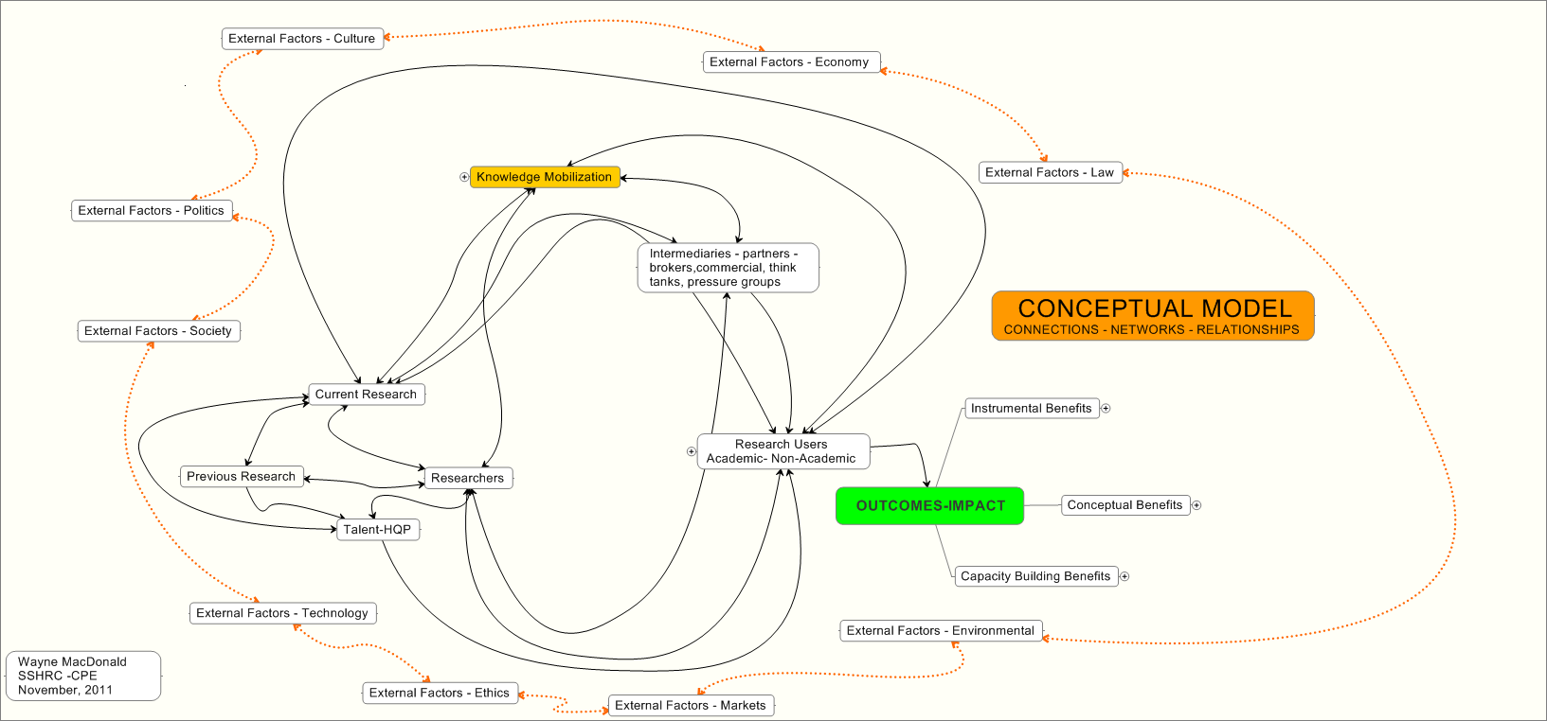

Slide 25
CONNECTING THE DOTS
Follow-up Questions
Research Grant for Bullying
Decreased Incidents of Bullying
Parent and Team Meetings
Research Activities
Workshop for Coaches
Video
Papers, Reports, Theses, Books, etc.
Knowledge Synthesis
Hockey Association Decision to Act

Slide 26
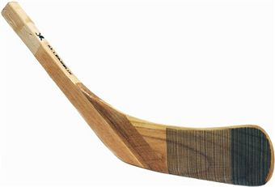
CONNECTING THE DOTS
Follow-up Questions
Research Grant for Bullying
Decreased Incidents of Bullying
Parent and Team Meetings
Research Activities
Workshops for Coaches
Video
Papers, Reports, Theses, Books, etc.
Knowledge Synthesis
Hockey Association Decision to Act

Slide 27
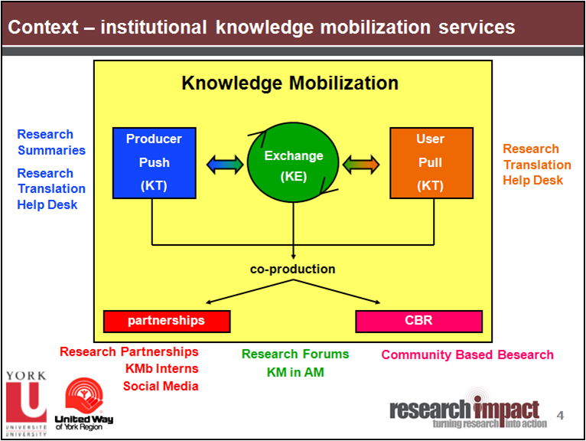

Slide 28
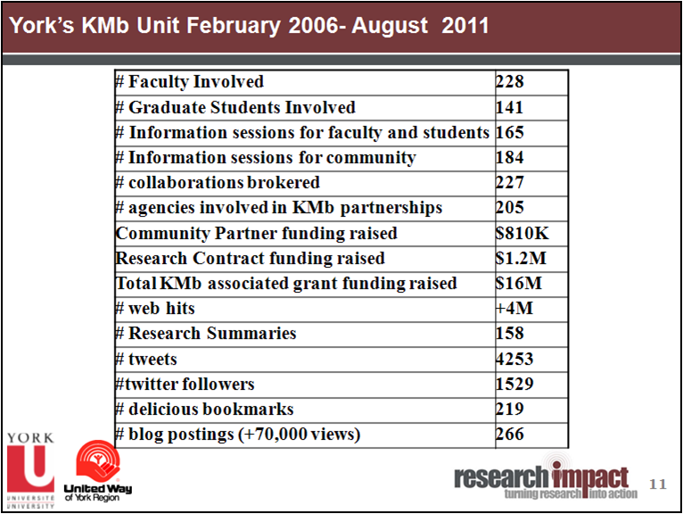

Slide 29
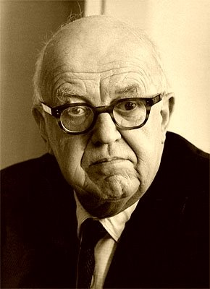
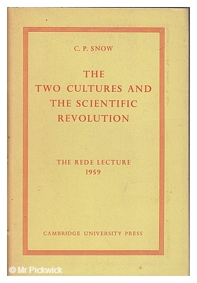

Slide 30


Slide 31

multidisciplinary

Slide 32

collaborative

Slide 33
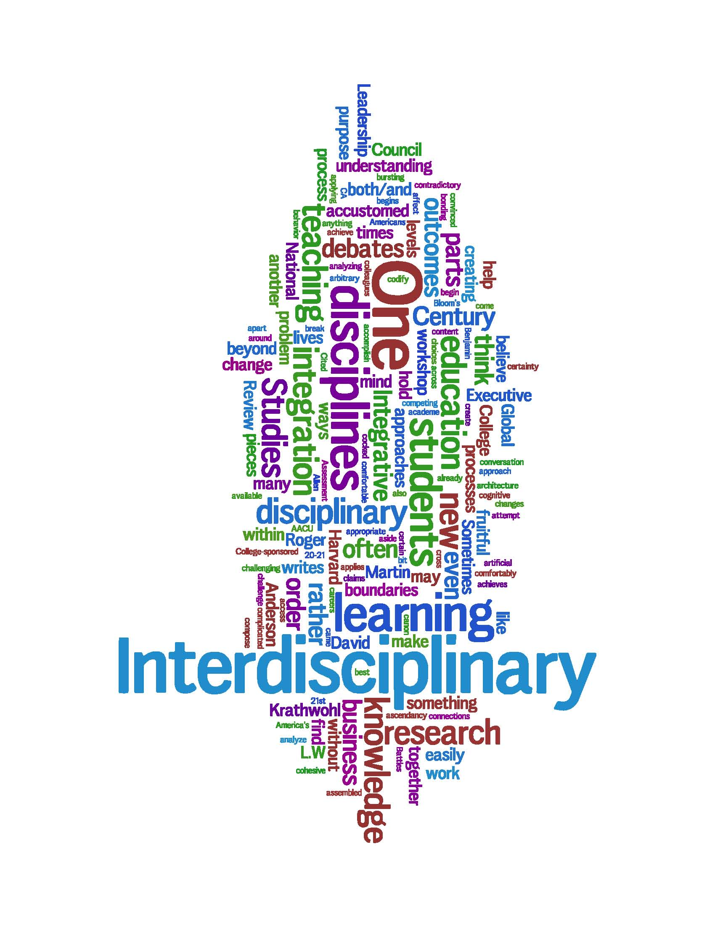

Slide 34
“On a scale ranging from extremely interdisciplinary to exclusively disciplinary, how would you characterize your research?”
Source: 2008 web survey, SSH faculty, Science-Metrix

Slide 35
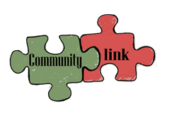
Socially engaged

Slide 36
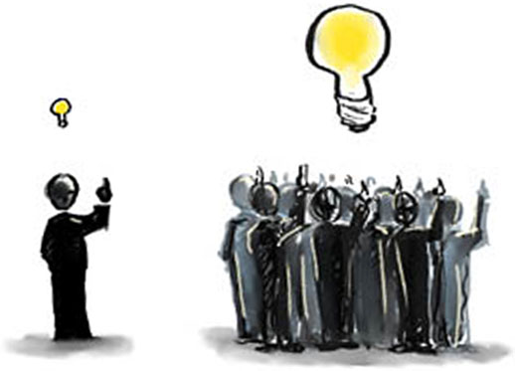
Notes:
Credentials: crowdsourcing
36

Slide 37
New Forms of Scholarly Engagement –
(accelerated and influenced by Open Access)
Public
Scholarly Engagement
Peers
Students

Slide 38

Berlin Declaration 2003
To promote the internet as a medium for disseminating global knowledge
To accelerate the pace of scholarship and research

Slide 39

Re-thinking the role of journals and university presses in the Digital Age.
Not simply about publishing printed journals and books.
Rather, publishers act as both a filter and a curator of knowledge, ideas, insights.
Notes:
39

Slide 40

What is the Filter?
University Credentials?
or
Crowdsourcing?
Notes:
University credentials – crowdsourcing
40

Slide 41
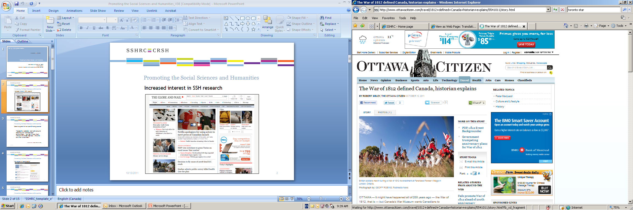
Special Features of the Social Sciences and Humanities
The public is interested in our topics!
Therefore, the public has expectations about being able to read intelligently about what is written.
Our journals have higher rejection rates (70-90%) than science, technology and medical journals (20-40%)
3. Shelf life…
Notes:
Rejection rates – from earlier slide
click through special features of ssh
41

Slide 42

“ …the following syllogism: (1) Scholars in the humanities sometimes use technical language. (2) I don’t understand it. (3) Therefore, they are ripping off both their students and the taxpayers…
Would she commit herself to the same claim about, say, kinesiologists, and their technical knowledge? Mathematicians?``
– Stephen Siemon, Edmonton,
Letter to the Editor, Globe and Mail, October 24th 2011

Slide 43

Crowdsourcing the Icelandic constitution!
“In creating the new document, the council has been posting draft clauses on its website every week since the project launched in April. The public can comment underneath or join a discussion on the council's Facebook page.”
“Mob rule: Iceland crowdsources its next constitution”,
by Haroon Siddique, The Guardian UK, June 9 2011. http://www.guardian.co.uk/world/2011/jun/09/iceland-crowdsourcing-constitution-facebook

Slide 44
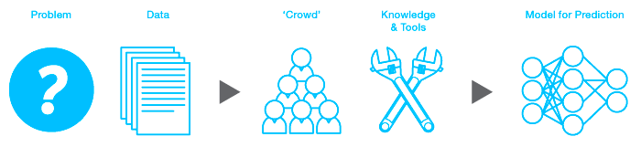
Kaggle: We’re making data science a sport.
Participate in competitions
Kaggle is an arena where you can match your data science skills against a global cadre of experts in statistics, mathematics, and machine learning. Whether you're a world-class algorithm wizard competing for prize money or a novice looking to learn from the best, here's your chance to jump in and geek out, for fame, fortune, or fun.
Create a competition
Kaggle is a platform for data prediction competitions that allows organizations to post their data and have it scrutinized by the world's best data scientists. In exchange for a prize, winning competitors provide the algorithms that beat all other methods of solving a data crunching problem. Most data problems can be framed as a competition.
http://www.kaggle.com/

Slide 45

Digital ≠ Analog
Digital Journals ≠ Analog Journals

Slide 46
“The internet economy has thus far belonged to the toolmakers (some of them Canadian) that built the infrastructure that made the digital age possible.
But the torch is being passed.
The future now belongs, at least equally, to the
tool users, the creative people, content providers, service deliverers, who have learned how to take the images, sounds, ideas and concepts and share them digitally.”
Tom Jenkins, Executive Chairman and Chief Strategy Officer
of OpenText and SSHRC Council member

Slide 47
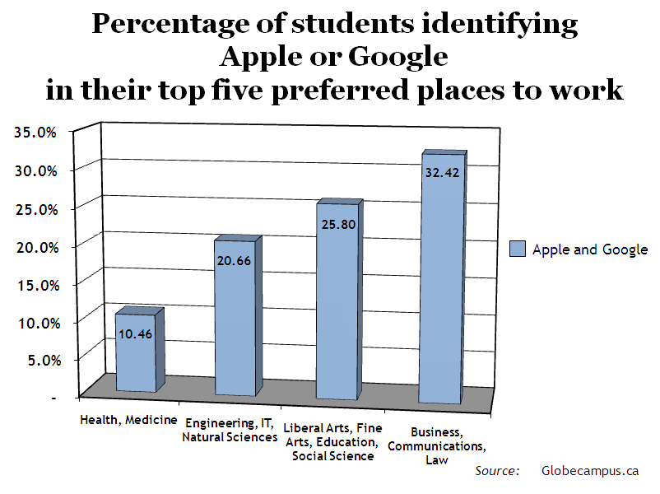

Slide 48
"We are going through a period of unbelievable growth and will be hiring about 6,000 people this year - and probably 4,000-5,000 from the humanities or liberal arts.“
    Marissa Mayer, Vice-President of Consumer Products, Google

Slide 50


International Partnerships
50

Slide 51
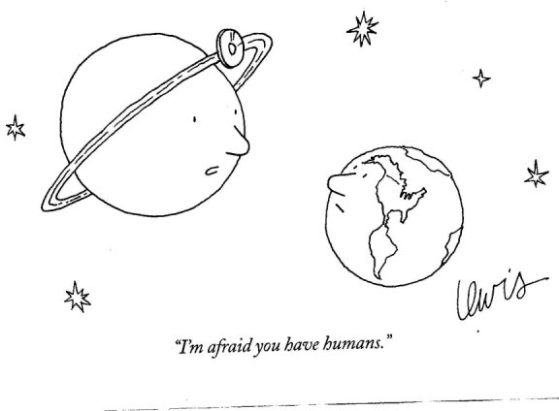

Slide 52


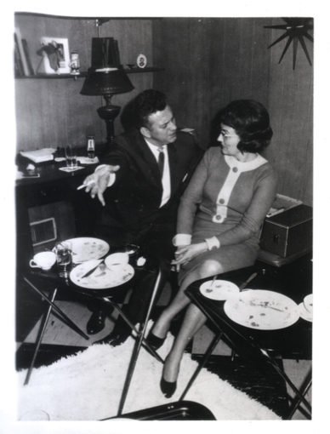
Notes:
Smoking

Slide 53
``Competition can promote innovation by reducing the value of failing to invest in research and development.
However, with non-exclusive intellectual property rights, competition
can reduce innovation incentives by lowering post-innovation profits.``
Richard J. Gilbert, ``COMPETITION AND INNOVATION``

Slide 54
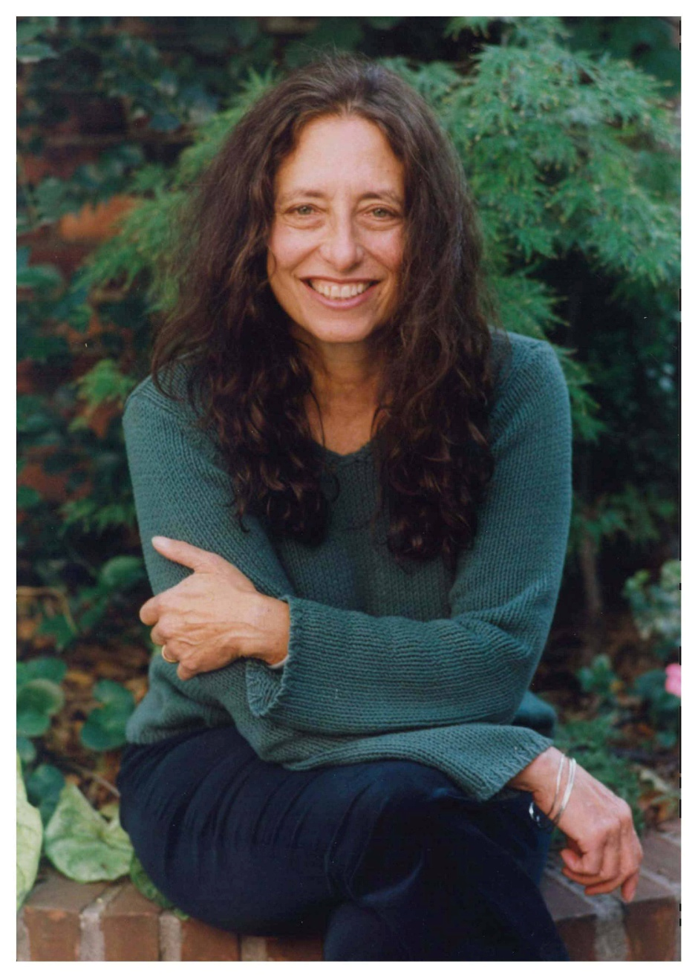
“…girls tend to avoid competition in favour of tactics that diffuse conflict and preserve interpersonal harmony.”
Carol Gilligan, In a different voice: Psychological theory and women's development, Cambridge, MA: Harvard University Press (1982)

Slide 55
Effective KMb: some rules of engagement
Ensure reciprocal benefit
In particular, ensure intellectual and academic benefit
Centre on import as much as, maybe more than, export
Widen the peer group: establish the legitimacy of a wider group of knowledge experts
Emphasize inclusion of new & diverse participants in the work of the university
Promote `teaching` (learning) as a powerful form of KMb
Notes:
Reciprocal relevance
Strengthening scholarship
The import perspective
Widening peer review
Building the university (inclusion)
Teaching as KMb

Slide 56
Conclusions thus far….
KMb creates a virtuous circle of reciprocal engagement that integrates intellectual & socio-economic impact
KMb is an ambitious & demanding effort to expand scholarly inquiry beyond the 20th century boundaries of campus-based research
KMb relies on, and invigorates, central academic functions such as peer review & teaching
KMb involves the application of democratic principles to generate ideas & insights that can help lead to prosperity, well-being and resiliency.
12/7/2011
56

Slide 57
KMb Steps forward at SSHRC:
KMb modules in all new programs
KMb evaluation criteria in all new programs
Notes:
Within the new PA, as of this last round, we have integrated KMb into all SSHRC grants
That means each application has a common module for knowledge mobilization AND each program has knowledge mobilization embedded within the evaluation criteria
Each applicaiton mentions that applicants should refer to out open access and data archiving policy and confrom to them as much as possible

Slide 58
Connection Grants
Launch early 2012
Continuous in-take model
Individuals; small teams; informal partners
Future roll-outs
  Institutional grants
  Research and research-related tools

Slide 59
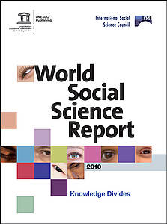

Slide 60
Defining the challenge
“In this new century the world will confront and will have to cope with and manage multiple, simultaneous and intertwined crises, e.g. how to:
reduce the gap between rich and poor AND address climate change;
promote economic growth AND bring about sustainable development;
raise life expectancies AND manage growing populations;
expand international exchange AND counter the threat of pandemics;
promote universal values AND maintain cultural diversity;
ensure secular concord AND respect the return of religion as a global force.”

Slide 61


“as a country with a unique experience of overcoming the scars of war and colonialism and achieving socioeconomic development, the Republic of Korea strives to become a world capital of humanism and to promote the role and values of humanities in this transformative era. Therefore, the Republic of Korea is pleased to host the World Humanities Forum 2011 in order to make important contributions towards this end.”
Secretariat
Korean National Commission for UNESCO

Slide 62

Notes:
Digitally Connected World

Slide 63


