Slide 1
Managing Your Online Reputation
Hunting Trolls and Hugging Angels
Tony Niederer, tony@cdmn.ca Director, Digital Media Marketing & Communications
Dec. 5, 2011
Notes:
Title Slide

Slide 2
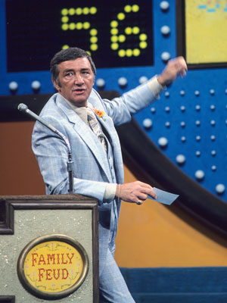
Wassup
Top tactics for better tracking and analysis
Free tools; new tools and trends
Attracting an audience and building a community – beyond the basics
Ensure our releases and communications reach the right audience and are read
Responding to negative feedback
Shared stories

Slide 3
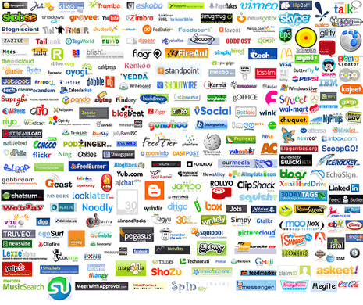
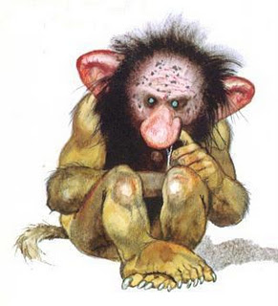
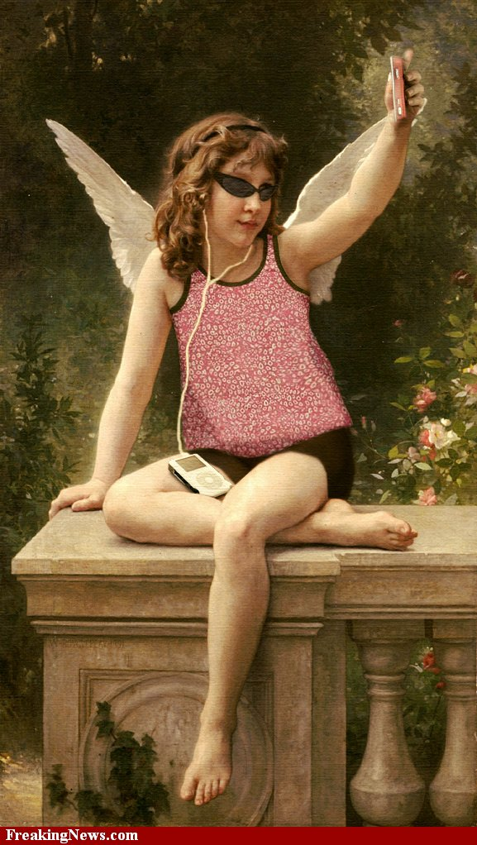

Slide 4
A Measurement Framework

Slide 5
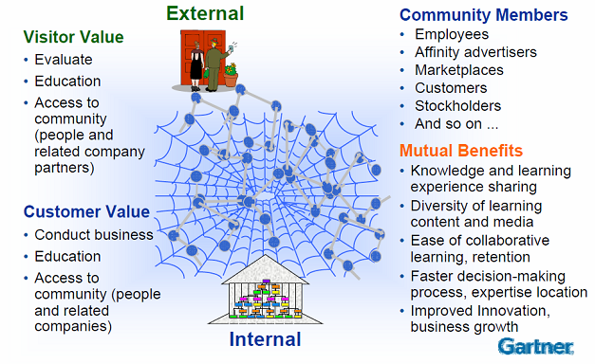
Inside, Outside, My Side
Gartner Portals, Content and Collaboration Summit 2008

Slide 6
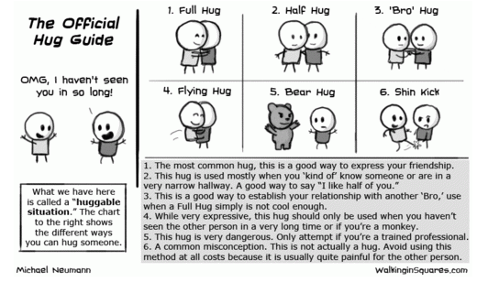

Slide 7
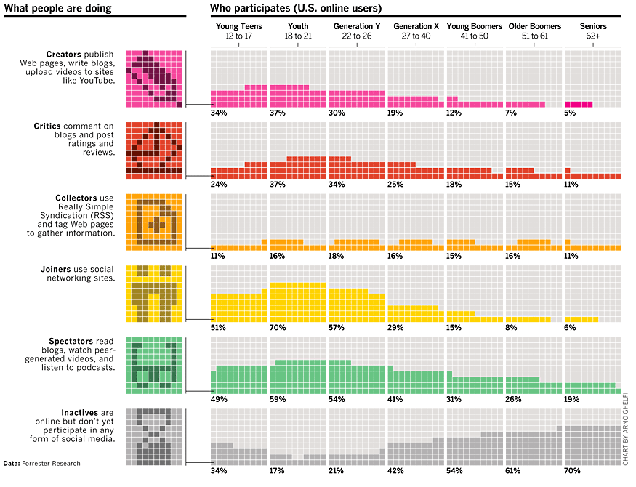
Engagement by Demographic
BusinessWeek June 2007

Slide 8
What contributes most to effectiveness?
People giving and getting help
Ability for community members to connect with other like-minded people: 54%
Ability for members to help others: 43%
Community focused on hot topic or issue: 41%
Quality of the community management team: 33%
Survey of organizations using online communities conducted by Beeline Labs, Deloitte, and the Society for New Communications Research
8
Notes:
What are people looking for in social media; how can you make sure you are relevant?
People want the ability to connect with others like them
They want to help others or be helped
They want to be engaged with hot topics
And they expect quality information in that community; corporate pablum and traditional marketing-ese is out

Slide 9
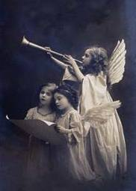
FourSquare’s 5 Laws of Engagement
Surround us with community-feeling of belongingness; post secrets, read other people’s secrets
Give us tools to express ourselves, be creative, be heard
Make us feel special through exclusivity and competition
We are hypnotized by beauty; give us something pretty to look at
We are captivated by the unknown; target our curiosity with surprise, have us organize and make order from chaos with a tease
But...don't use the 5 laws to exploit; use it to make us feel better about ourselves
Siobhan Quinn, FourSquare, Google

Slide 10
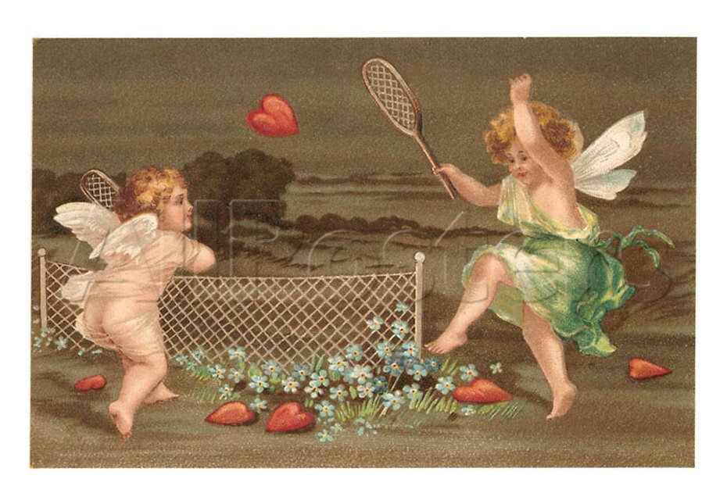

Slide 11
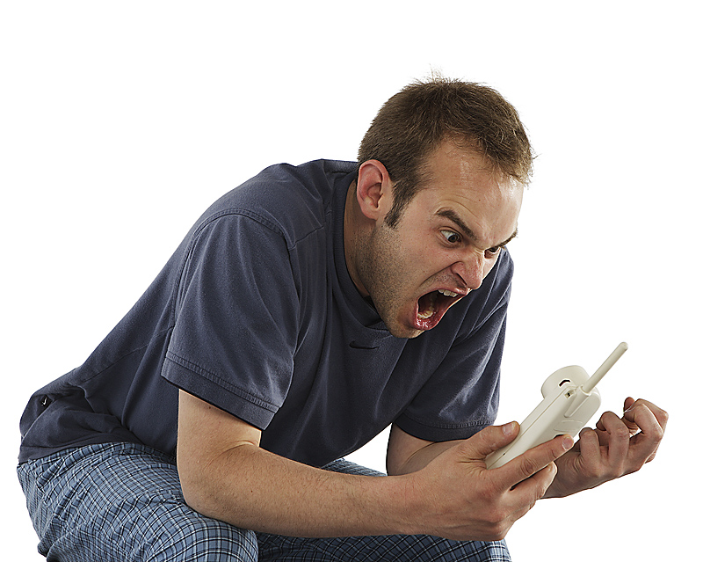
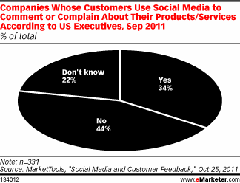
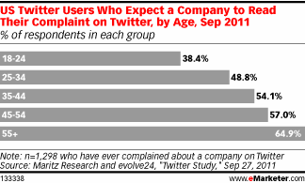
Distant Early Warning Systems

Slide 12
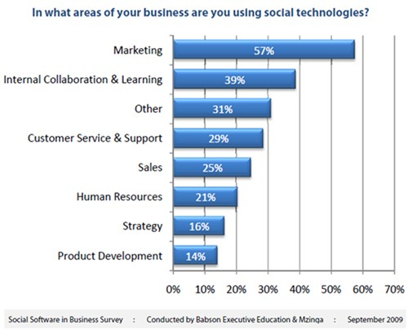
Distant Early Warning Systems

Slide 13
Google Alerts is Tool of Choice
Popular Social Media Monitoring Tools
% of respondents, August 2011
Source: WebLiquid and RSW/US
Senior marketing executives in the WebLiquid survey named Google Alerts as the most popular social media monitoring tool among survey respondents, with slightly more than 45% reported usage.
“Not monitoring social media” was the second most-popular response.

Slide 14
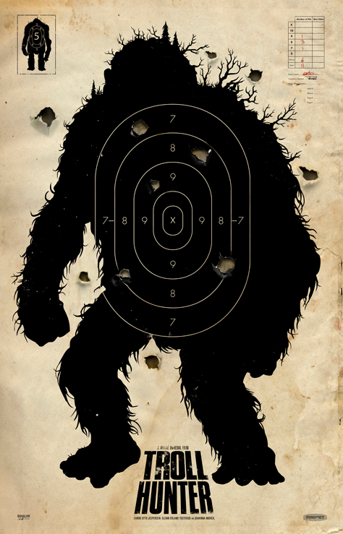
Troll Hunting
www.socialmention.com
www.tweetdeck.com
www.google.com/alerts
www.facebook.com/insights
www.linkedin.com/searchAnswers
www.google.com/reader
www.blogpulse.com
www.google.com/blogsearch
http://technorati.com
www.video-alerts.com
http://boardreader.com
http://tumblring.net/track-tumblr-traffic-visitors/

Slide 15
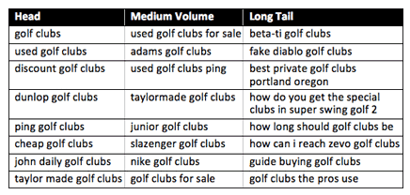
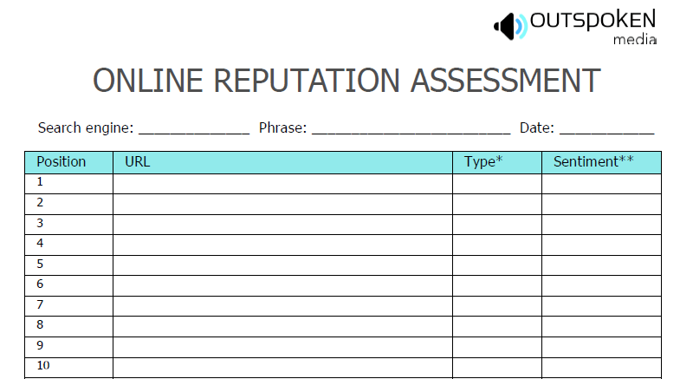
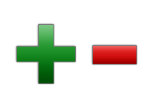
More Troll Hunting Tools
NASA/Newsmakers

Slide 16
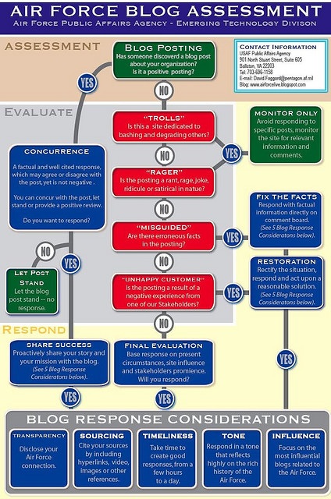
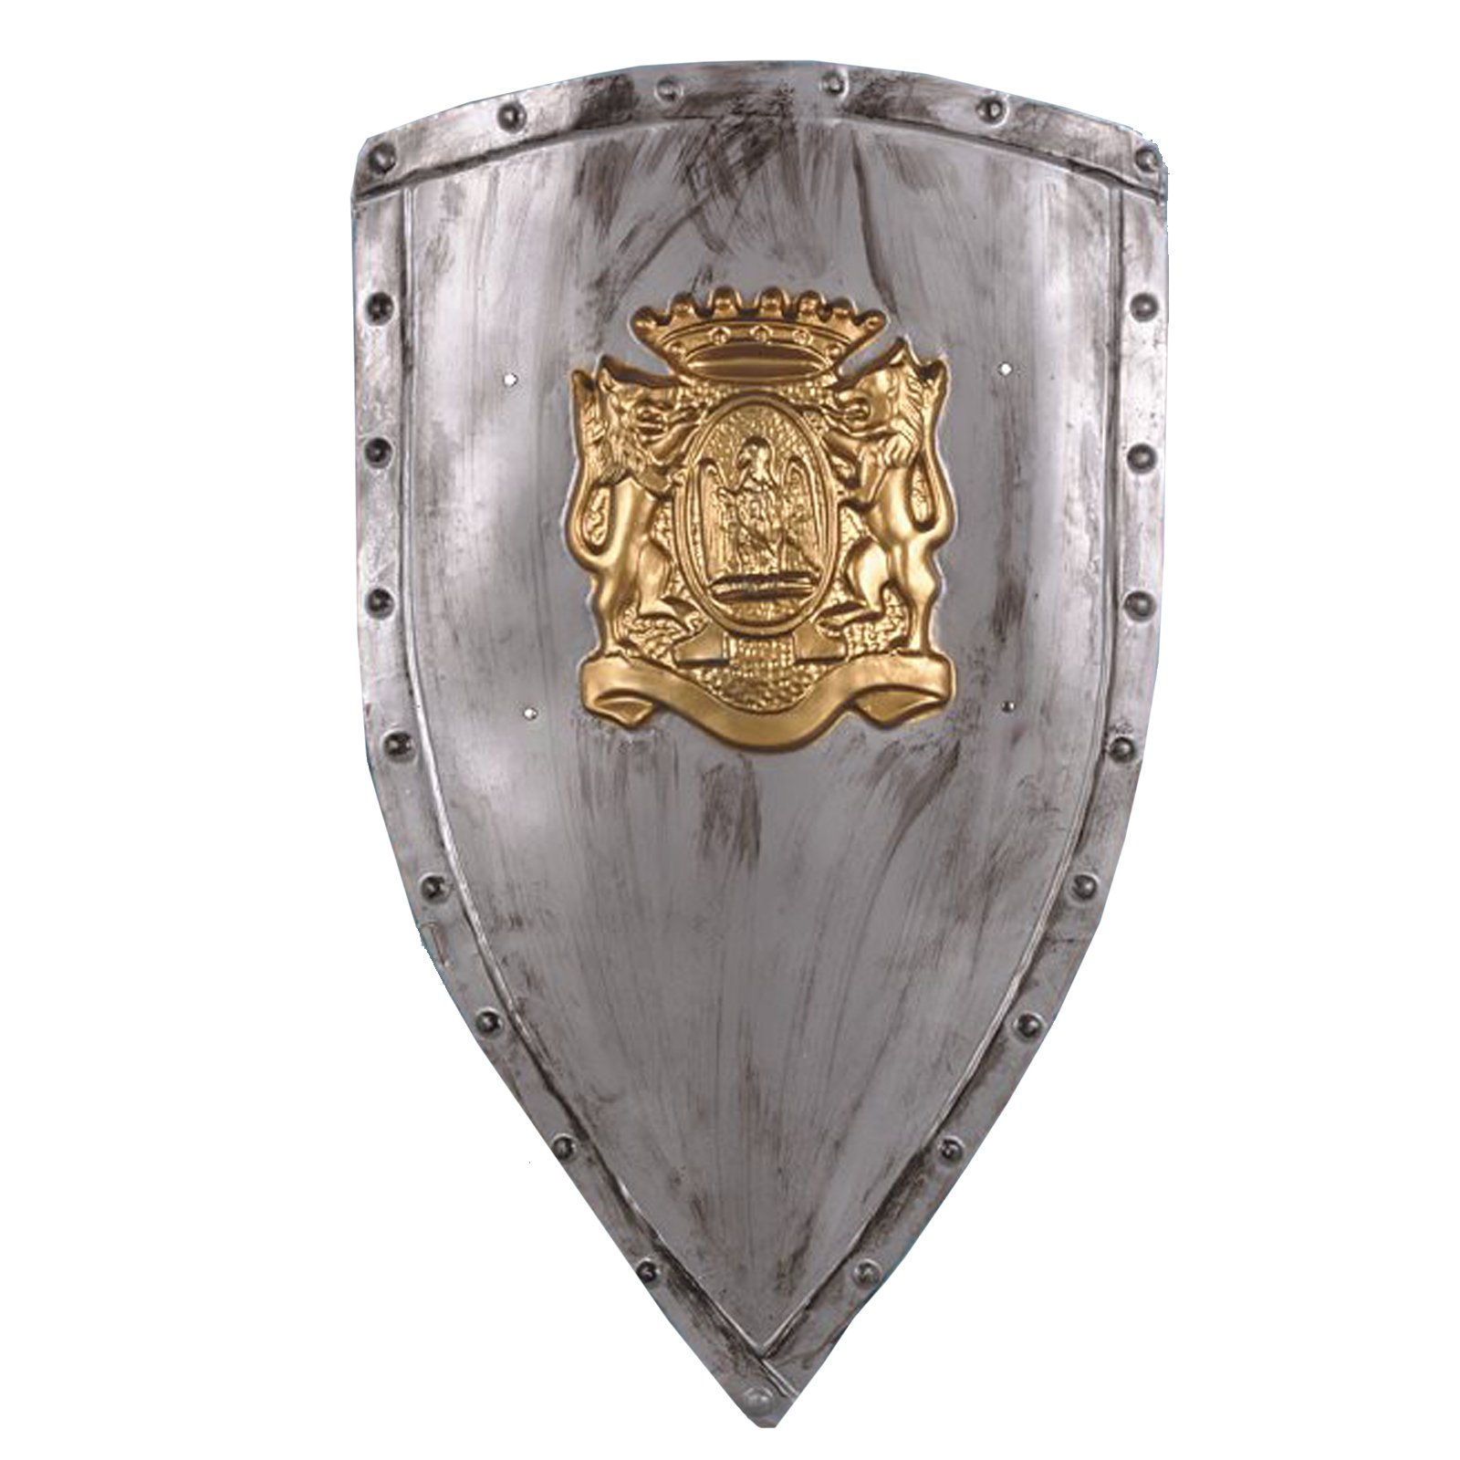
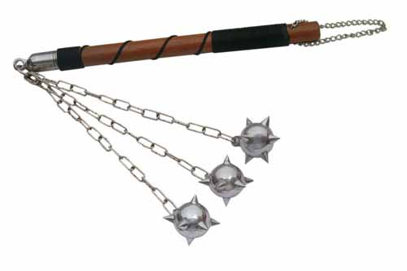
Reasonable Force
http://www.flickr.com/photos/jeremiah_owyang/3154057414/sizes/o/

Slide 17
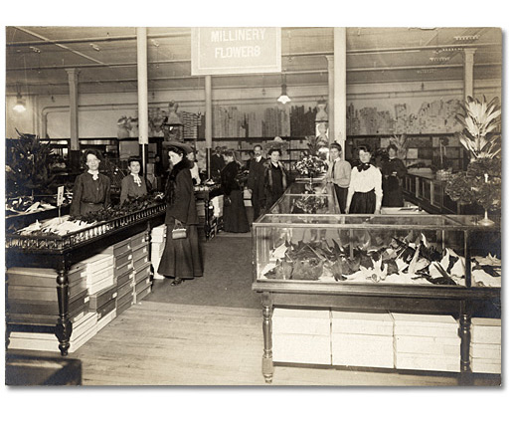
Vanquishing Trolls
Always say thank you
Address the issue
Correct any misinformation
Be transparent and honest
Recognize the opportunity
Emily Harris, Ogilvy

Slide 18
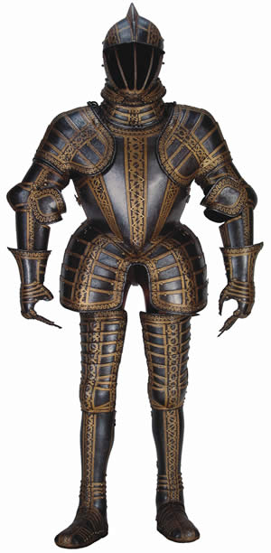
Be Prepared
http://websitegrader.com
http://jigsaw.w3.org/css-validator
www.google.com/analytics
www.hubspot.com
http://blog.ogilvypr.com
www.techvibes.com
www.emarketer.com
www.comscore.com
http://www.nce-rce.gc.ca/_rss/NewsReleasesXML_eng.asp
http://www.ic.gc.ca/eic/site/ic1.nsf/eng/02936.html

Slide 20
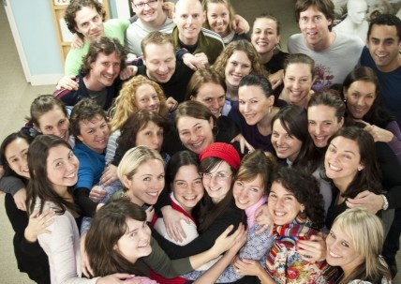

Slide 21
Managing Your Online Reputation
Hunting Trolls and Hugging Angels
Tony Niederer, tony@cdmn.ca Director, Digital Media Marketing & Communications
Dec. 5, 2011
Notes:
Title Slide

