Slide 1

Innovation Policy in Canada
Tom Jenkins
December 5, 2011
Ottawa

Slide 2
My Innovation Background
Chair, Review of Federal Support to R&D Panel
Panel Member, Federal Competition Policy Review Panel
Member, Institute For Competitiveness & Prosperity
Board Member, CD Howe, SSHRC, CCCE, CIC
Chair, Canadian Digital Media Network CECR
Board Member, GRAND NCE
Executive Chair and CSO, Open Text Corporation

Slide 3
Innovation in Canada Agenda
Macro
  Motivation
  Reports on this topic
  Major insights of these Reports
  Action Plan
Micro
  Centres of Excellence Co-ordination
  Generating Wealth
3

Slide 4
Innovation in Canada Agenda
Macro
  Motivation
  Reports on this topic
  Major insights of these Reports
  Action Plan
Micro
  Centres of Excellence Co-ordination
  Generating Wealth
4

Slide 5
Management Lesson
A crow was sitting on a tree, doing nothing all day. A small rabbit saw the crow, and asked him, "Can I also sit like you and do nothing all day long?
The crow answered: "Sure, why not. So, the rabbit sat on the ground below the crow, and rested. All of a sudden, a fox appeared, jumped on the rabbit and ate it.
Management Lesson:
To be sitting and doing nothing, you must be sitting very, very high up.
5

Slide 6
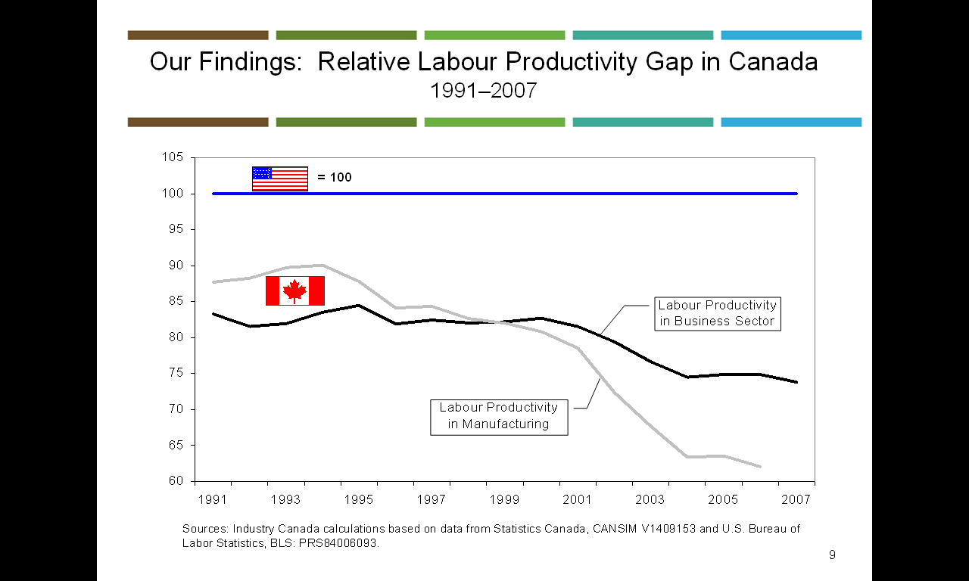
Poor Relative Productivity Performance
6

Slide 7
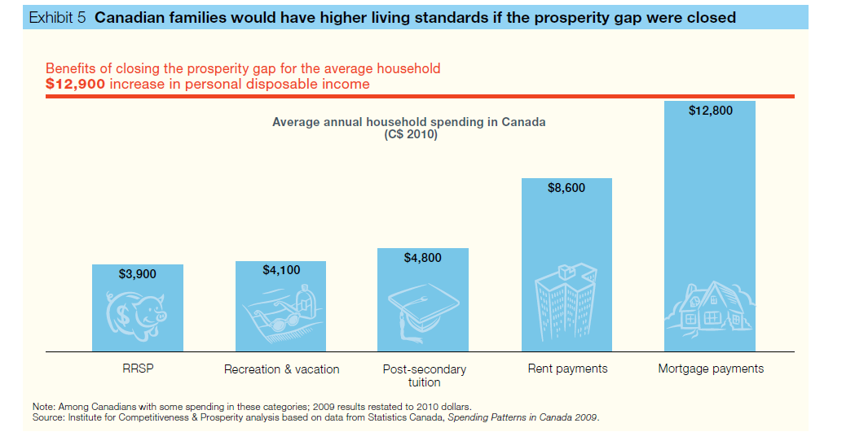
Impact on Standard of Living
7

Slide 8
Innovation in Canada Agenda
Macro
  Motivation
  Reports on this topic
  Major insights of these Reports
  Action Plan
Micro
  Centres of Excellence Co-ordination
  Generating Wealth
8

Slide 9
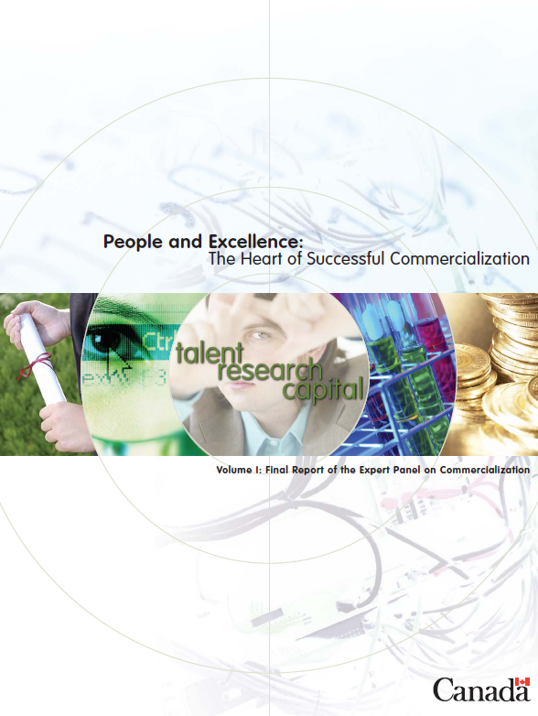
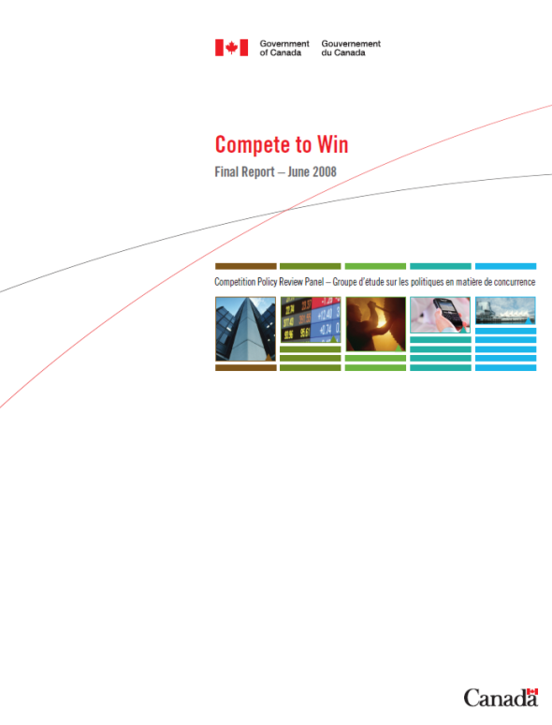
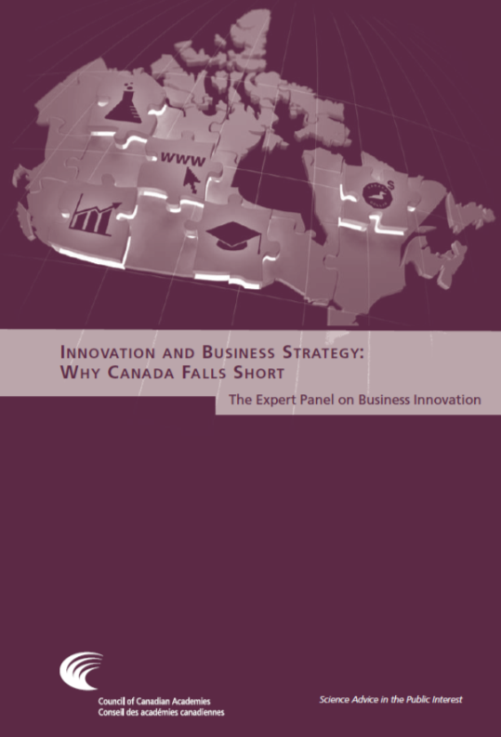



Innovation Related Reports
9

Slide 10
Innovation in Canada Agenda
Macro
  Motivation
  Reports on this topic
  Major insights of these Reports
  Action Plan
Micro
  Centres of Excellence Co-ordination
  Generating Wealth
10

Slide 11
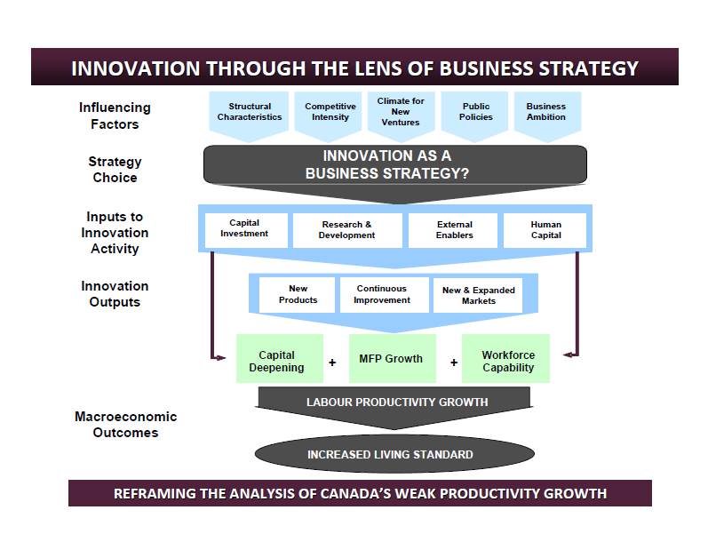
CCA Innovation Architecture
11

Slide 12
Foundation Principle
Competition
Innovation
Productivity
12

Slide 13
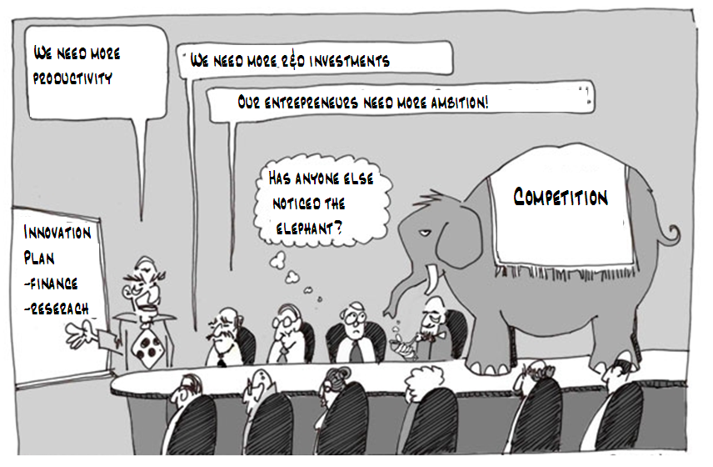
Competition: The Elephant in the Room
13

Slide 14
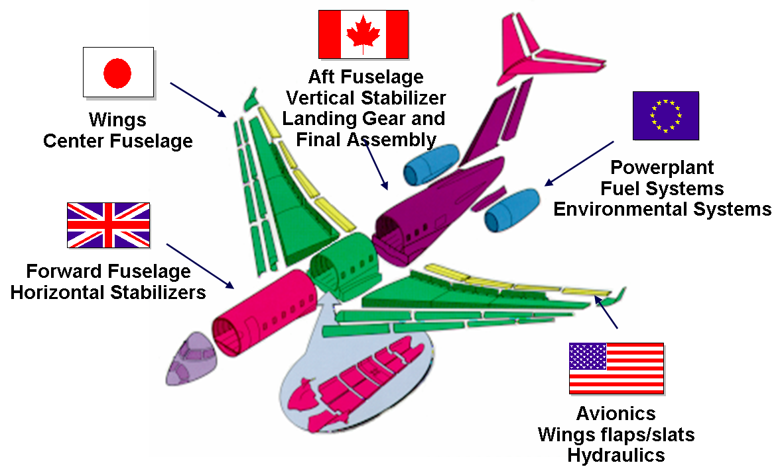
Global Value Chains: Bombardier
These value chains have changed the basis of competition in the world
Source: Industry Canada
14
Notes:
A global value chain is the process whereby the production of increasingly complex goods and services is organized across international borders. The term “value chain” captures the linkages in activity required to bring a product from conception through final production to market. This can include design, production, marketing, distribution and support activities. Whether a complex product like an aircraft or Blackberry, or something as “simple” as a fashionable article of clothing, firms are competing for participation in successive stages of production.
Many of the same phenomena described above that have contributed to globalization (e.g., declining trade barriers, growth in the importance of technology, burgeoning investment flows, decreasing transportation costs) have also contributed to the growth in global value chains.
Firms have become more flexible, horizontally organized enterprises, converting from geographically concentrated production networks to geographically dispersed networks.

Slide 15
The Rise of BRIC as % of World GDP
15
Notes:
In the past, developed countries maintained their advantage by using their advanced technology and skilled labour to export manufactured goods to developing countries. Then, companies reoriented their operations, designing products in developed countries but assembling products in lower-cost developing countries. Now, competition can come from anywhere, and high-tech products can be designed and engineered in what was formerly referred to as the developing world and disseminated via global distribution networks.
In 2007, emerging economies produced just over half of world output and accounted for more than half of the increase in global gross domestic product. These economies are rapidly becoming a major force in the world economy. As their prosperity increases, so will their demand for resources. Since the early 1990s, for example, China’s shares in world consumption of oil, aluminum and steel have doubled.

Slide 16
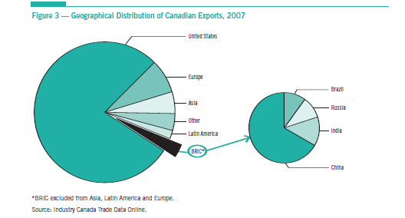
Canadian Exports By Destination
BRIC was only 3% of total
16

Slide 17
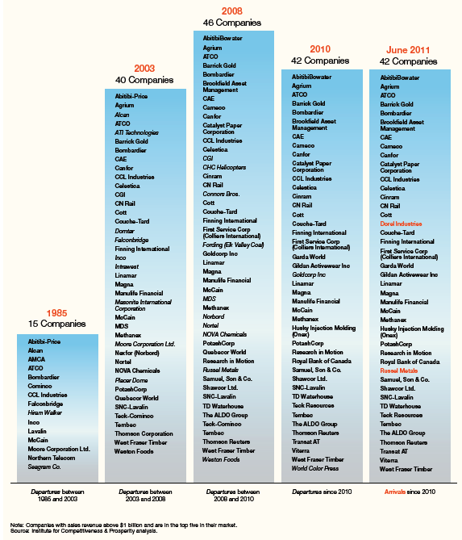
Canadian Based Global Leaders
From 1985 to 2011, Canada has gone from 15 to 42 corporations which are considered global leaders.
Less than 10% of these global leaders are from sectors with protection regimes.
17

Slide 18
Sectoral Regimes
Transport
Uranium
Telecommunications
Broadcast
Financial Services
Culture
18

Slide 19
Sectoral Regimes Background
30 year old legislation
Major policy concern at the time was entry into NAFTA
Less than 10% of the North American market is Canadian
Control of national sovereignty an understandable concern
Selected sectors were (and are) integral to the infrastructure to Canada
19

Slide 20



The World has Changed Dramatically
Internet
Mobile
Global Value Chains

Slide 21
Sectoral Restrictions: Telecom
Cellular Mobile Penetration Rates, 2005

Slide 22
Sectoral Regimes Issues
The Sector Regimes were created prior to the Internet
30 years ago, policy interventions were surgical as sectors were not tightly integrated
Today, the Internet now links many of the infrastructure sectors to the entire economy as well as the global economy
Poor productivity in an enabling sector may be leading to poor productivity in other sectors
22

Slide 23
Logic Flow
sub-optimal
Competition
leads to
sub-optimal
Innovation
leads to
sub-optimal
Productivity
23

Slide 24
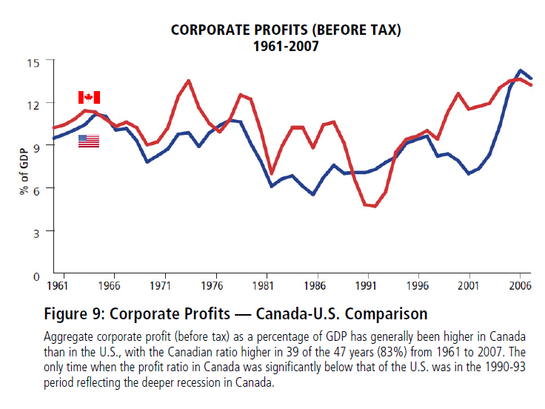
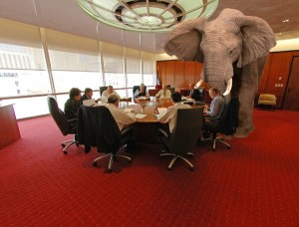
Canadian Firms Enjoy Higher Profits some may have flexibility to set prices to meet profit goals
24

Slide 25
Currency - A complicating factor
A very simple view of the Canadian economy is that it has two segments identified with different regions:
  “The West” – Commodity based
  “The East” – Manufacturing & Services
Innovation has an impact for both regions but some of the natural economic feedback mechanisms between internal Canada economies can vary by segment of the economy
While Currency can be a “productivity safety valve” by having the currency decline thereby making relative productivity higher.
In the case of a “petro dollar” the currency is instead driven by commodity demand and cannot serve as a safety valve.
Innovation in the East is the only economic strategy to resolve these differences. This becomes central to economic and social policy in Canada.
25

Slide 26
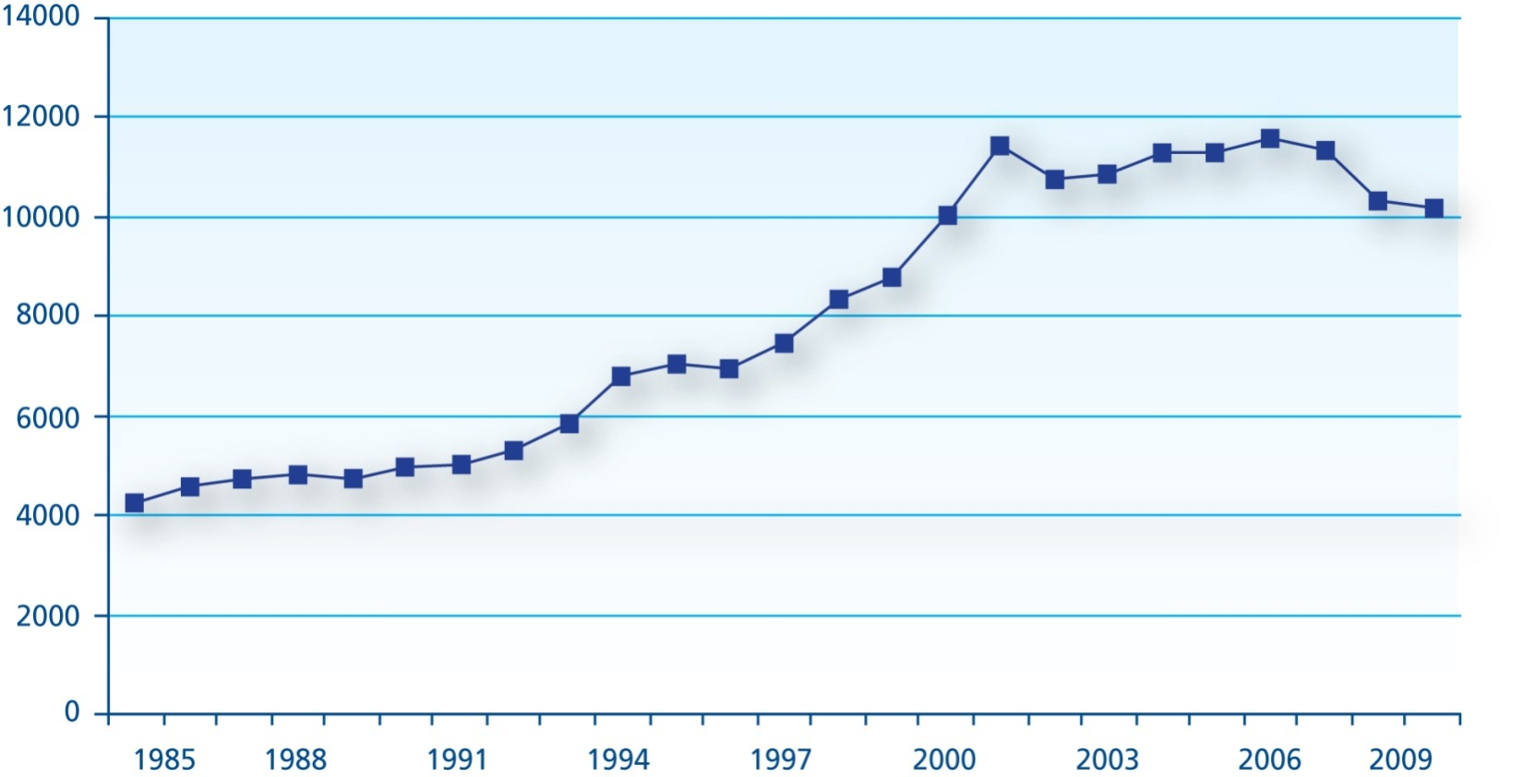
Canadian Business Expenditure on Research and Development (BERD), 1985-2010 (billions of 2000 constant dollars)
Canadian Business R&D expenditures are stalled

Slide 27
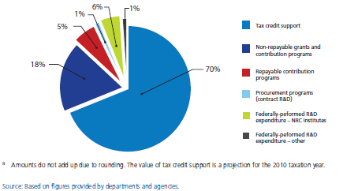
Overwhelmingly through indirect support (SR&ED)
SRED

Slide 28
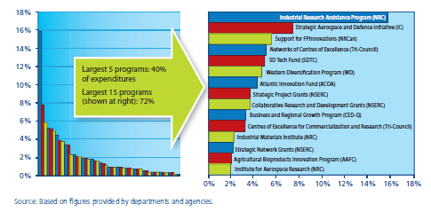
With complex array of small direct support programs

Slide 29
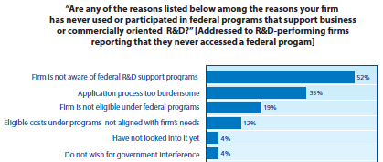
Firms have trouble finding / using these programs

Slide 30
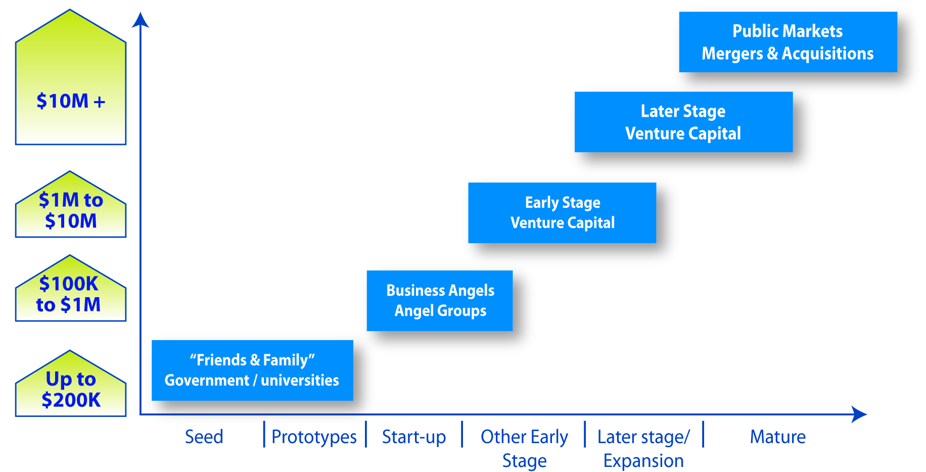
“Gaps” in Angel and Late-Stage Capital

Slide 31
Innovation in Canada Agenda
Macro
  Motivation
  Reports on this topic
  Major insights of these Reports
  Action Plan
Micro
  Centres of Excellence Co-ordination
  Generating Wealth
31

Slide 32
Need for Focus
The boy rode on the donkey and the old man walked. As they went along, they passed some people who remarked, "it was a shame the old man was walking and the boy was riding". The man and boy thought maybe the critics were right so they changed positions. Later, they passed some people that remarked, "What a shame, he makes that little boy walk." They decided they both would walk! Soon they passed some more people who thought they were stupid to walk when they had a decent donkey to ride. So they both rode the donkey!
Now they passed some people that shamed them by saying "how awful to put such a load on a poor donkey". The boy and man said they were probably right so they decided to carry the donkey. As they crossed a bridge, they lost their grip on the animal and he fell into the river and drowned.
Management Lesson:
If you try to please everyone, you will eventually lose your ass.
32
Notes:
Read the slide…..as with all things in life, it is important to focus and to not try to keep every body happy.

Slide 33
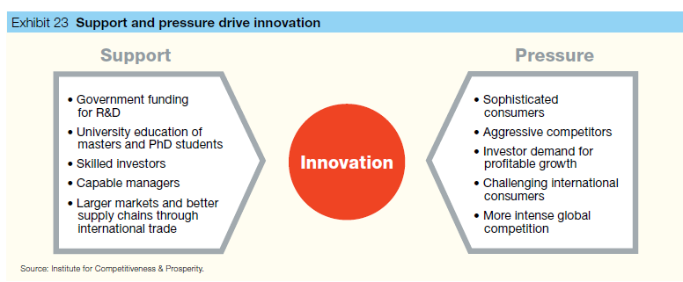
A Balanced Model for Innovation
33

Slide 34
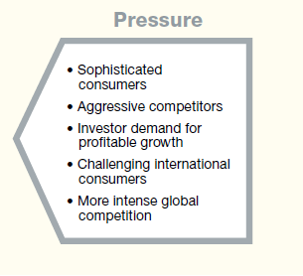
Competition Report: Review Sectoral Regimes
Transport
Uranium
Telecommunications
Broadcast
Financial Services
Culture
34

Slide 35
Competition Report: Competitiveness Council
Maintain a sustained focus on competitiveness.
  broad mandate: publish research and be a public advocate for competition in the public and private sectors;
  independent of government: small staff and a Board of Directors with a majority of members from outside government.
The Council is arguably the most important recommendation to spur innovation in Canada.

Slide 36
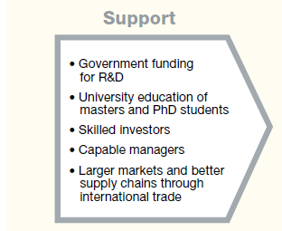
R&D Report: Six Recommendations

Slide 37
Panel composition
Chair: Mr. Thomas Jenkins
Executive Chairman and Chief Strategy Officer, Open Text
Dr. Bev Dahlby
Professor and Fellow, University of Alberta
Dr. Arvind Gupta
CEO, MITACS and Professor, University of British Columbia
Ms. Monique Leroux
CEO, Desjardins
Dr. David Naylor
President, University of Toronto
Mrs. Nobina Robinson
CEO, Polytechnics Canada

Slide 38
The Review process
Consultations:
  32 roundtable sessions: 164 participants in 9 cities across country.
  228 written submissions received.
  International consultations in seven key countries and extensive bilateral meetings with provincial governments.
Research:
  Assessed 60 federal programs delivered by 17 different departments and agencies.
  Survey of over 1,000 R&D performing firms.
  Analysis from a range of experts.

Slide 39
Scope of the Review
Tax incentive programs (i.e., SR&ED).
Business innovation support programs.
Funding for business-focused R&D at universities, polytechnics, colleges, non-profits, and federal agencies.
NOT: Basic Research or Federal Research

Slide 40
Mandate
What federal initiatives are most effective in increasing business R&D?
Is the current mix and design of tax incentives and direct support for business R&D appropriate?
What, if any, gaps are evident in the current suite of programming, and what might be done to fill the gaps?

Slide 41
Recommendation 1: Focus
Create an Industrial Research and Innovation Council (IRIC), with a clear business innovation mandate (including delivery of business-facing innovation programs, development of a business innovation talent strategy, and other duties over time), and enhance the impact of programs through consolidation and improved whole-of-government evaluation.

Slide 42
Recommendation 2: Simplify SR&ED
Simplify the SR&ED program by basing the tax credit for SMEs on labour-related costs. Redeploy funds from the tax credit to a more complete set of direct support initiatives to help SMEs grow into larger, competitive firms.
42

Slide 43
Recommendation 3: Innovation in Procurement
Make business innovation one of the core objectives of procurement, with the supporting initiatives to achieve this objective.
43

Slide 44
Recommendation 4: Evolve NRC
Transform the institutes of the National Research Council (NRC) into a constellation of large-scale, sectoral collaborative R&D centres involving business, the university sector and the provinces, while transferring NRC public policy-related research activity to the appropriate federal agencies.
44

Slide 45
Recommendation 5: Strengthen Risk Capital
Help high-growth innovative firms access the risk capital they need through the establishment of new funds where gaps exist.
45

Slide 46
Recommendation 6: Innovation Leadership
Establish a clear federal voice for innovation, and engage in a dialogue with the provinces to improve coordination and impact.
46

Slide 47
Innovation in Canada Agenda
Macro
  Motivation
  Reports on this topic
  Major insights of these Reports
  Action Plan
Micro
  Centres of Excellence Co-ordination
  Generating Wealth
47

Slide 48


The Role of Centres of Excellence

Slide 49
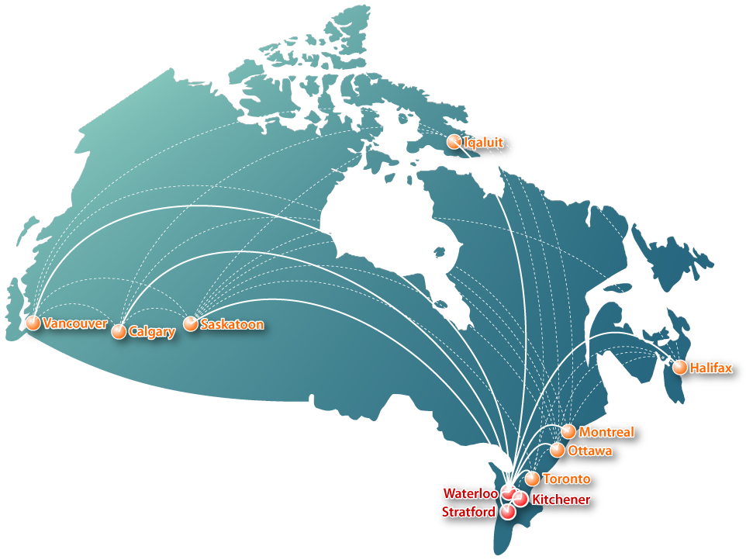

Slide 50



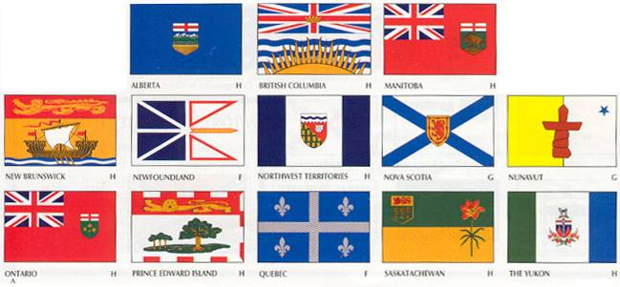
A Digital Public Private Partnership

Slide 51












































CDMN Partnership

Slide 52
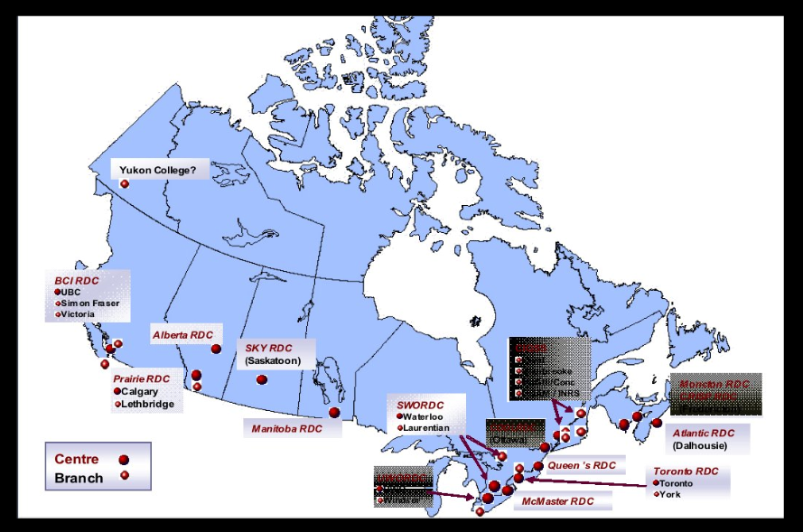
Digital Media in Universities

Slide 53

SSHRC and Digital Humanities

Slide 54

Canada 3.0 Conference in Stratford
Notes:
This can be found at www.canada30.ca
Page 54

Slide 55









































Canada 3.0 Participation – 6,000 Participants

Slide 56

2,000 Attendees & 4,000 Online

Slide 57












Canada 3.0 - 150 Speakers from across Canada

Slide 58

Canada 3.0 - 500 Secondary School Students
- Workshops, Keynotes, Showcase Tours -

Slide 59
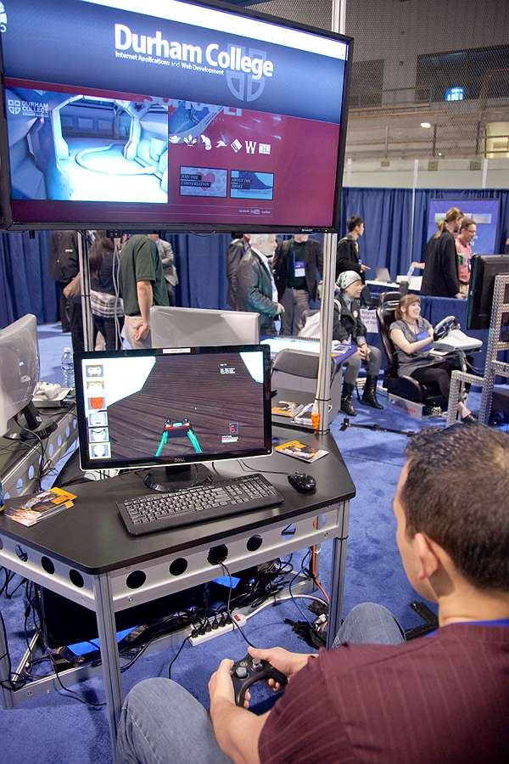


Canada 3.0 - Industry Showcase & Venture Capital

Slide 60
Innovation in Canada Agenda
Macro
  Motivation
  Reports on this topic
  Major insights of these Reports
  Action Plan
Micro
  Centres of Excellence Co-ordination
  Generating Wealth
60

Slide 61




Facilitating Global Governance

Slide 62

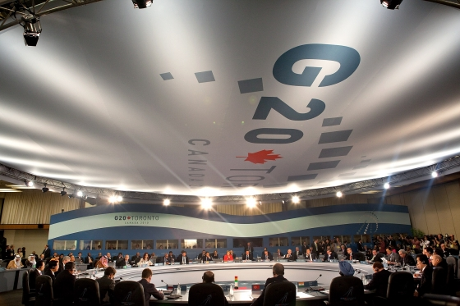
G20 Research Demonstration Project

Slide 63
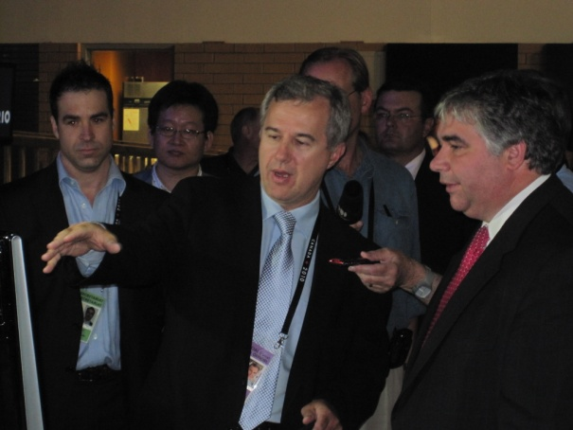

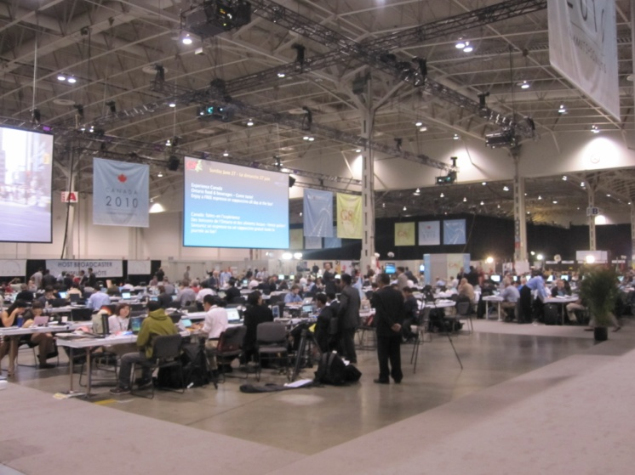
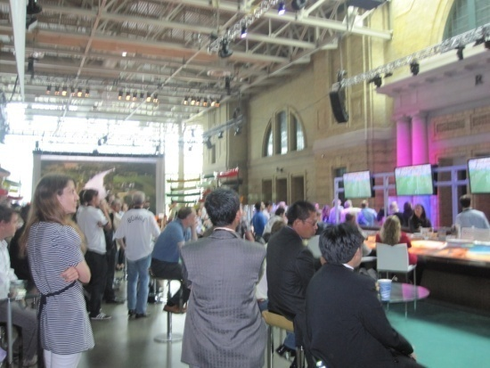
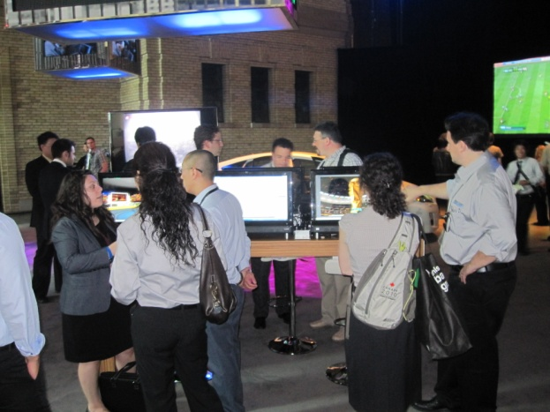

Research Collaboration@G20

Slide 64
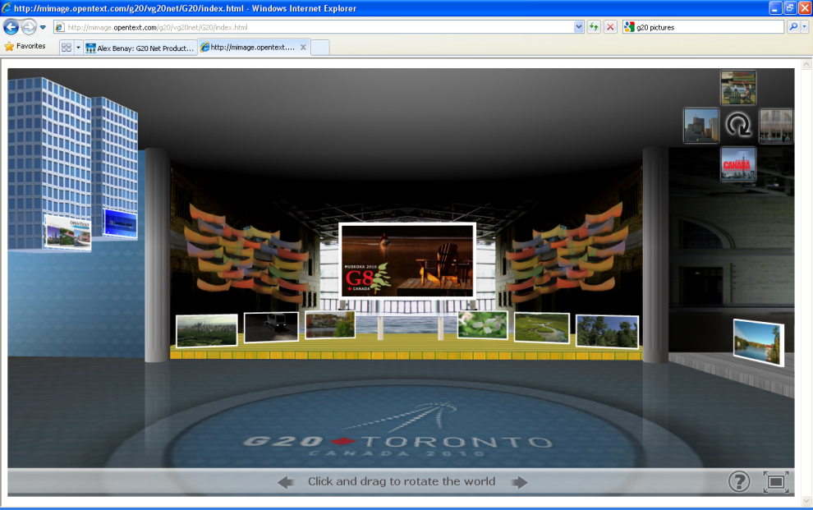

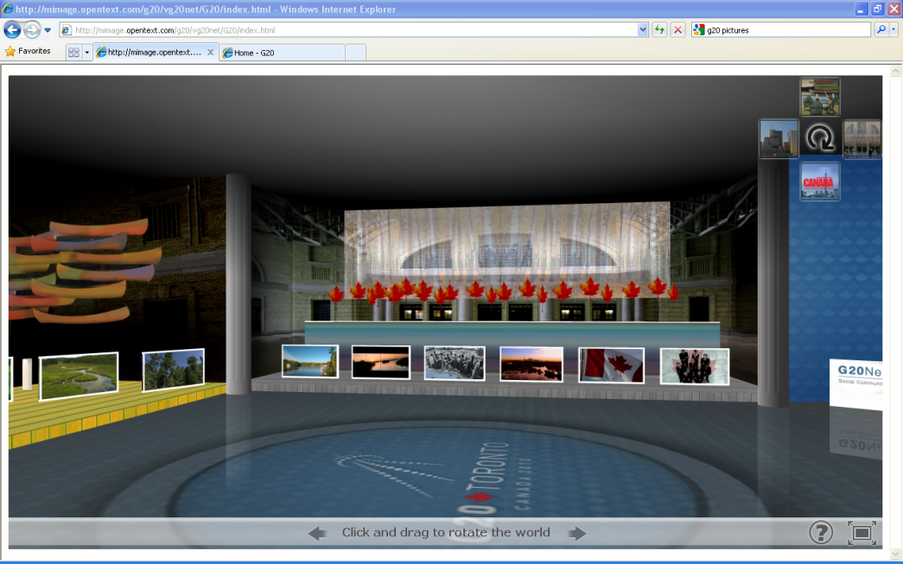
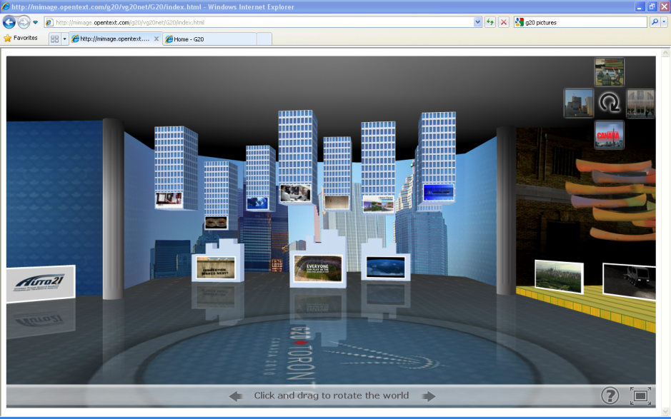
New Online Immersive Technologies

Slide 65

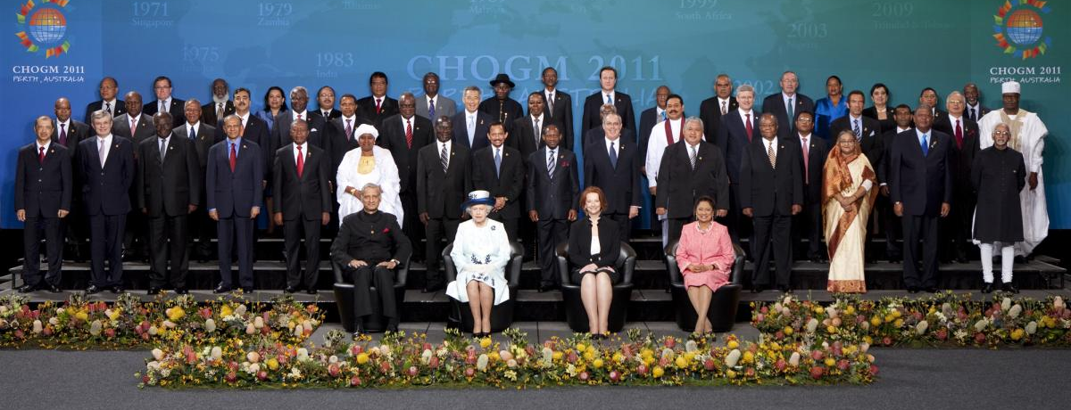
Commonwealth

Slide 66

Digital Outreach
Program
Expanding Markets For CECR/NCE Members
April 23-26, 2012 Stratford

Slide 67
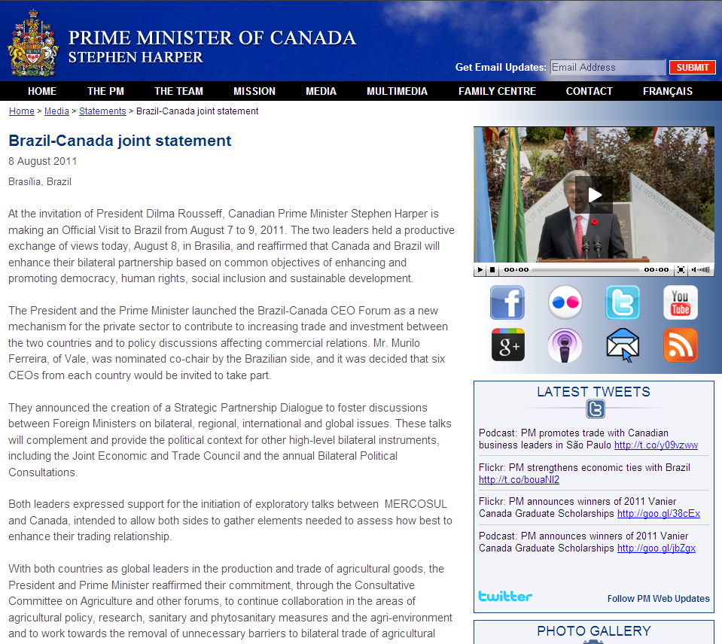

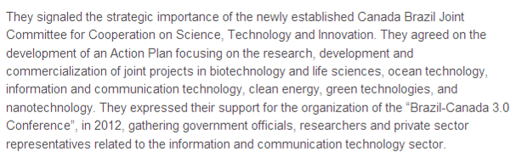
Expanding the Canada 3.0 Reach

Slide 68
Extending the Canada 3.0 Conference
Other countries seek the same policy dialogue:
  Brazil
  India
  Germany
  Australia
  South Africa
  Japan
  Netherlands
  Spain
April 23-26, 2012 Stratford
Slide 68

Slide 69
Innovation in Canada Agenda
Macro
  Motivation
  Reports on this topic
  Major insights of these Reports
  Action Plan
Micro
  Centres of Excellence Co-ordination
  Generating Wealth
Conclusion: Balance!
  Social & Economic
  Support & Pressure
  Macro & Micro
69

Slide 70
Thank You

